Slide 1

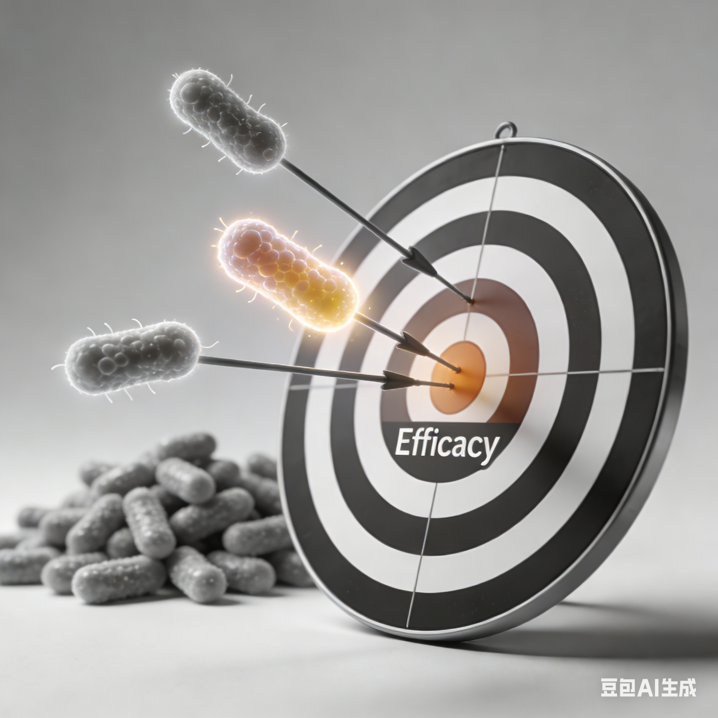
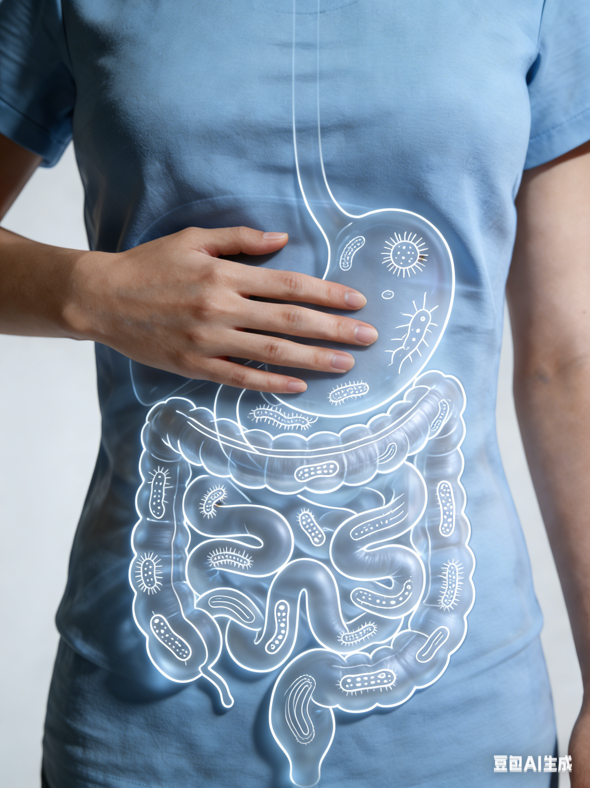
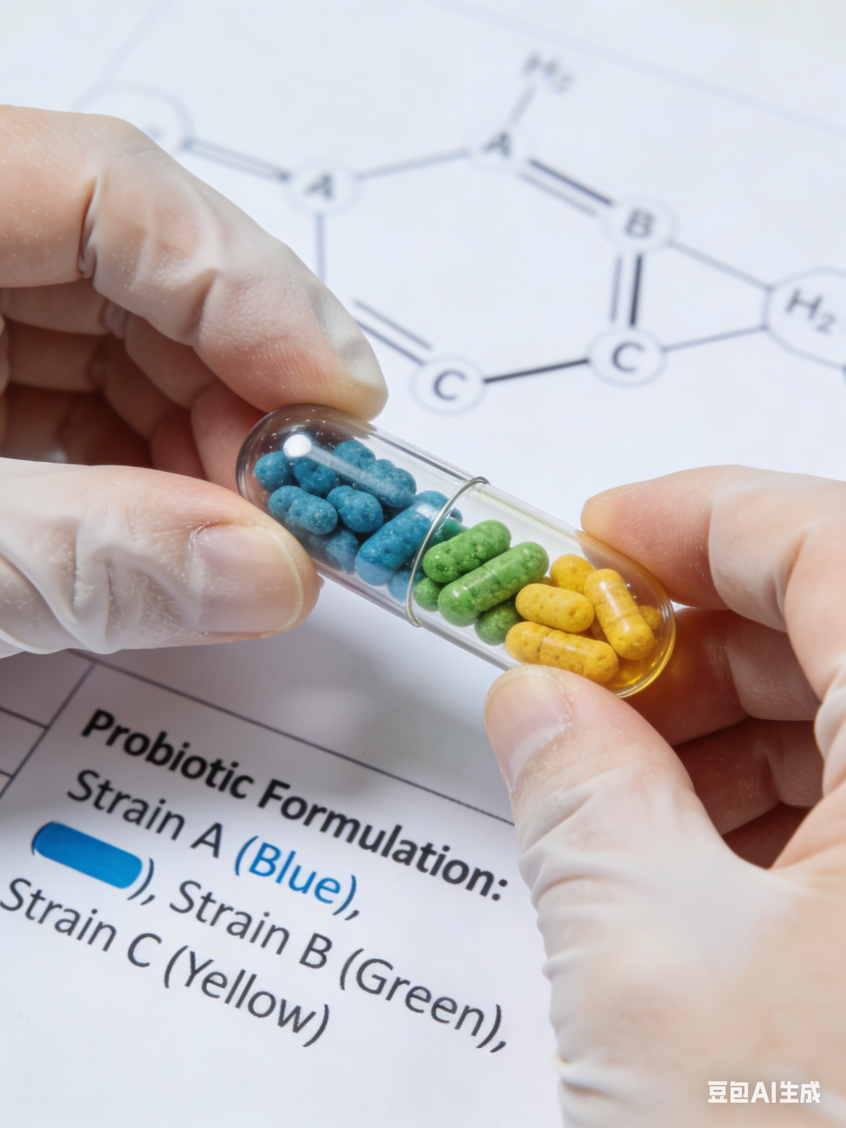
The Challenge: Why We Developed WecPro®?
Our mission: Bridging the gap
The current market is highly homogenised, with many products defining function at a broad, conceptual level rather than delivering precise, function-targeted outcomes.
WecPro® was developed to deliver high cell count, function-driven, formula-based solutions with proven performance and gut tolerance.
Precision
Functionality
Reliability
Accessibility
Gut complexity requires multi-strain, formula-based solutions
Integrate function-driven design into traditional strain-count marketing
WecPro® tested for gut tolerance and consistency
Ready-to-use formulas + Expert formulation support
Notes:
Intro: The human gut ecosystem is highly complex and dynamic.
It is not defined by a single strain, but by interactions between multiple microbial strains, substrates, and environmental factors.Traditional single-strain or generic products often fail to deliver consistent results because they do not account for:Individual gut variability, Functional synergy between strains, The presence of inhibitory or supportive co-ingredients
Industry Pain Points
Despite rapid growth in microbiome research, the market faces several key challenges:
1. One-size-fits-all products: Most solutions focus on strain count rather than function and suitability.
2. Limited functional specificity: For example, many products claim “gut health” broadly, without clear, measurable targets.
3.Human tested for gut tolerance and consistency：our formulas were clinically tested multipe times for gut tolerace and consistentency. （pro test; 目前厂家反馈都比较正
4. Our formulas and solutions are ready to use and fully customizable. Our R&D and formulation teams provide services and tools to optimize each formula for your specific needs.

Slide 2

WecPro®—Precision Formulation for Targeted Functions
To address these limitations, we developed WecPro® that combine selected strains with complementary ingredients to achieve targeted, functional outcomes.
Scientific Approach
—— From Strains to WecPro®
Multi-strain design based on proven health benefits
Functional excipients supporting colonisation and driving targeted efficacy
Optimised for gut tolerance, safety, and functional precision
Notes:
To address these limitations, we developed WecPro that combine selected strains with complementary ingredients to achieve targeted, functional outcomes.
Our Scientific Approach – From Strains to Wecpro
Our company specializes in strain research, functional validation, and formulation science.Instead of selling individual strains, we designed integrated formulas that:
Combine multiple strain with proven functions.
Include supportive excipients that enhance colonization, activity, stability, and actively contribute to functional efficacy.
Are optimized for gut tolerance, safety, and functional precision
Precision Matters – 43 Targeted Formulas
We have developed 43 distinct formulas, each precisely designed for a specific functional goal,

Slide 3
WecPro®: Targeted Formulas, Personalized Health.
Precision Matters
7
43
Metabolic Health
Targeted Formulas
Targeted Solutions
Women's Health
Mental Health
Supported by 100+ Clinical Trials
Gastrointestinal Health
Each designed for a specific functional goal
WeSmile
WecPro® can be customized based on our core strains
Infant
Health
Immunological Health
7 Formulas

Slide 4

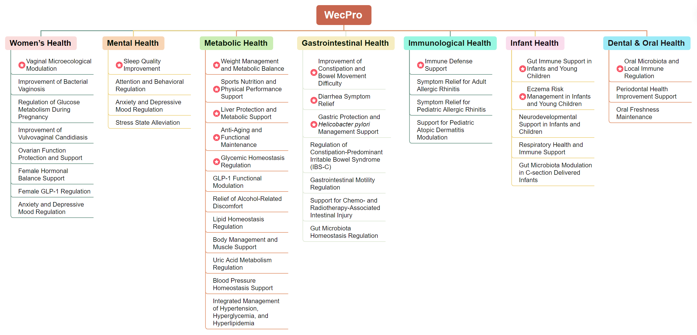
WecPro®
- 7 Targeted Formulations, 43 Solutions to Wellness
WecPro
Formula
Solution

Slide 5








WecPro®-Women’s Health
Designed specifically for women’s health
Supports vaginal microbiome balance, helps address vaginitis-related concerns, and promotes hormonal and metabolic homeostasis for women’s well-being.
Solutions
Improvement of Bacterial Vaginosis
Regulation of Glucose Metabolism During Pregnancy
Improvement of Vulvovaginal Candidiasis
Vaginal Microecological Modulation
Ovarian Function Protection and Support
Female Hormonal Balance Support
Female GLP-1 Regulation
Anxiety and Depressive Mood Regulation
18+
Clinical Studies
LRa05
Lacticaseibacillus
rhamnosus
LCr86
Lactobacillus
crispatus
LR08
Limosilactobacillus
reuteri

Slide 6

Solution
Vaginal Microecological Modulation
Lacticaseibacillus rhamnosus LRa05; Lactobacillus crispatus LCr86;
Limosilactobacillus reuteri LR08; Lactiplantibacillus plantarum Lp90;
pasteurized Akkermansia muciniphila Akk11; Weizmannia coagulans BC99
Key Excipients: Cranberry Powder; Vitamin C
Other Excipients: Inulin; Acacia Gum; Potato Starch
Functionality
6 Strains
Optimizes vaginal microbiota structure
Improves vaginal micro-ecological balance
Promotes production of beneficial metabolites
Optional Excipients
Powder / Capsule Form
Scientific Support
CLINICAL STUDIES
LRa05: ChiCTR2400080481 NCT06821789 NCT06901791 | LCr86: NCT06830122 | pAkk11: NCT06964932 NCT06964919
LRa05+LR08: NCT07013409 | Lp90: NCT06987279 | BC99: NCT06629441

Slide 7
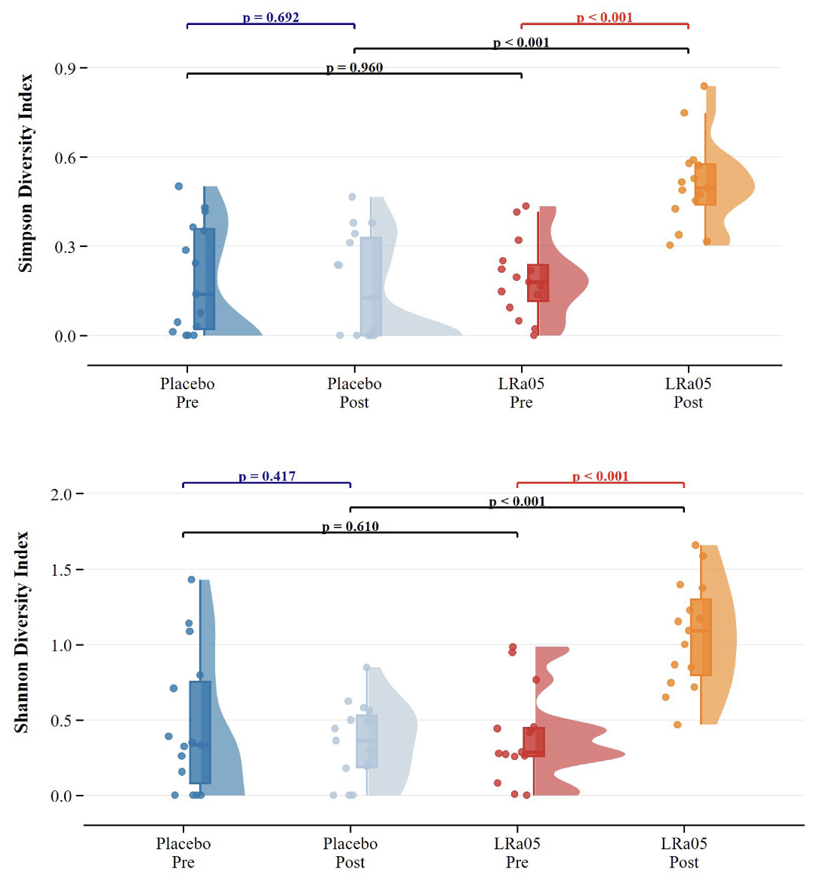

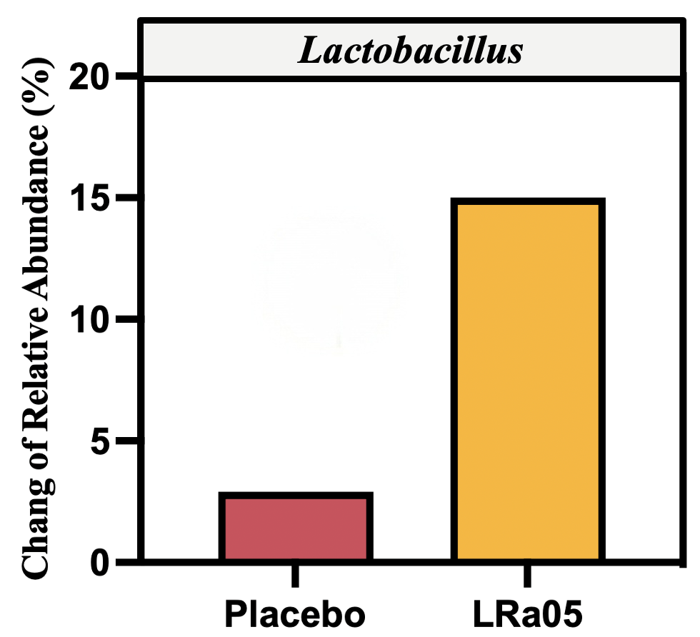
Solution
Vaginal Microecological Modulation
Research Outcome
Significantly enhanced microbial diversity and reshaped the vaginal micro-ecosystem structure
Increased the relative abundance of beneficial Lactobacillus species and reestablishes dominant microbiota
Effectively reduced Candida positivity rates and lowered the recurrence risk of fungal vaginosis.
15%
Placebo Pre
Placebo Post
Probiotic Pre
Probiotic Post
2.9%
Placebo Probiotic
Placebo Pre
Placebo Post
Probiotic Pre
Probiotic Post
Both the Simpson and Shannon indices significantly increased.
Probiotics can remodel the structure of the vaginal microbiome.
Probiotics effectively promoted the colonisation and dominance of beneficial Lactobacillus species.
Partial data shown. More data available...

Slide 8
Solution
Improvement of Bacterial Vaginosis
Lacticaseibacillus rhamnosus LRa05; Lactobacillus crispatus LCr86;
Limosilactobacillus reuteri LR08; Bifidobacterium animalis subsp. lactis BLa80;
Bifidobacterium breve BBr60; Weizmannia coagulans BC99
Key Excipients: Cranberry Powder
Other Excipients: Inulin; Potato Starch
Functionality
6 Strains
Addresses bacterial vaginosis effectively
Improves Nugent score metrics
Enhances vaginal cleanliness significantly
Optional Excipients
Powder / Capsule Form
Scientific Support
CLINICAL STUDIES
LRa05: NCT06821789 | LCr86: NCT06830122 | LRa05+LR08: NCT07013409
BLa80: NCT06107049 | BBr60: NCT06196892 | BC99: NCT06629441

Slide 9
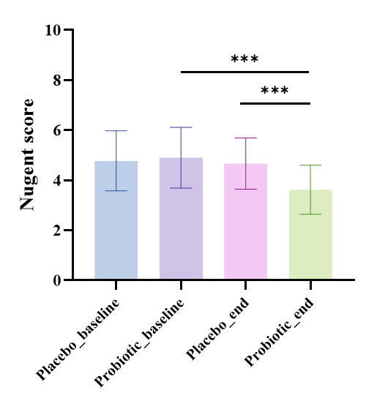
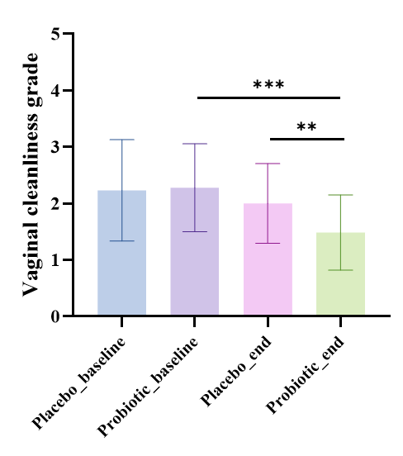
Solution
Improvement of Bacterial Vaginosis
Promoted a healthy vaginal microbiome
Improved vaginal cleanliness
Research Outcome
Significantly reduced Nugent score (diagnostic gold standard) , effectively improved the vaginal microenvironment and promoted the restoration of Nugent scores to the normal range.
Improve vaginal cleanliness and promote the restoration of a healthy vaginal microbiome.
Systematically promoted the restoration of microbial structure to a healthy state.
Nugent scores were significantly reduced.
Effectively improves the vaginal microenvironment and promotes the restoration of Nugent scores to the normal range.
Vaginal cleanliness scores were significant decreased.
Probiotic intervention can markedly improve vaginal cleanliness and promote the restoration of a healthy vaginal microbiome.

Slide 10
Solution
Regulation of Glucose Metabolism During Pregnancy
Lacticaseibacillus rhamnosus LRa05; Lactobacillus crispatus LCr86;
Limosilactobacillus reuteri LR08; Bifidobacterium animalis subsp. lactis BLa80;
Bifidobacterium longum subsp. longum BL21; Bifidobacterium breve BBr60;
Weizmannia coagulans BC99
Key Excipients: Vitamin D3; Vitamin K2; Ferrous Fumarate
Other Excipients: Fructo-oligosaccharides; Potato Starch
Functionality
7 Strains
Significantly reduce fasting blood glucose and improves glycemic homeostasis
Enriches beneficial sugar-metabolizing bacteria, such as bifidobacteria
Inhibits the proliferation of metabolically harmful bacteria
Optional Excipients
Powder / Capsule Form
Scientific Support
CLINICAL STUDIES
LRa05: NCT06901791 | LCr86: NCT06830122 | LRa05+LR08: NCT07013409
BLa80: ChiCTR2300073412 | BL21: ChiCTR2300073299 | BBr60: NCT06305650
BC99: NCT06629441

Slide 11
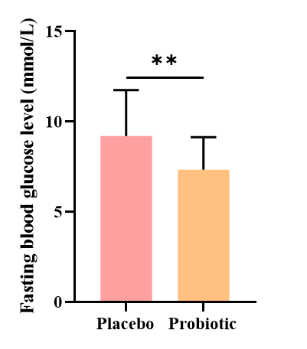
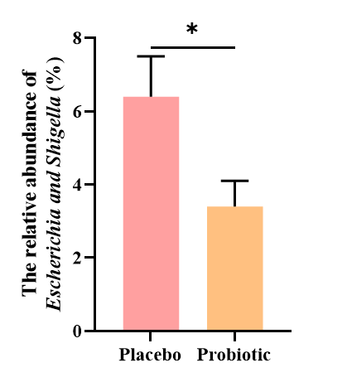
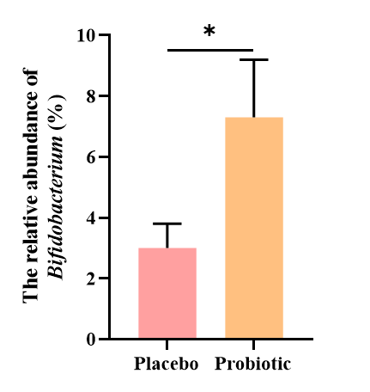
Solution
Regulation of Glucose Metabolism During Pregnancy
Significantly reduce fasting blood glucose
Effectively modulate gut microbiota
Research Outcome
Significantly reduced fasting blood glucose levels
Markedly enriched beneficial bacteria such as Bifidobacteria
Effectively cleared harmful bacteria such as Escherichia-Shigella.
The fasting blood glucose level of the patients was significantly reduced after probiotic intervention.
The relative abundance of Bifidobacterium significant increased.
The relative abundance of Escherichia-Shigella significant decrease.

Slide 12
Solution
Improvement of vulvovaginal candidiasis
Lacticaseibacillus rhamnosus LRa05; Lactobacillus crispatus LCr86;
Limosilactobacillus reuteri LR08; Pediococcus acidilactici PA53;
Lactiplantibacillus plantarum Lp90; Weizmannia coagulans BC99
Key Excipients: Cranberry Powder
Other Excipients: Inulin; Fructo-oligosaccharides; Potato Starch
Functionality
6 Strains
Precisely inhibits Candida colonization
Rapidly restores vaginal cleanliness
Repairs the mucosal barrier and alleviates vaginal inflammatory responses
Optional Excipients
Powder / Capsule Form
Scientific Support
CLINICAL STUDIES
LRa05: ChiCTR2400080481 | LCr86: NCT06830122 | LRa05+LR08: NCT07013409
PA53: NCT06648590 | Lp90: NCT06987279 | BC99: NCT06629441

Slide 13
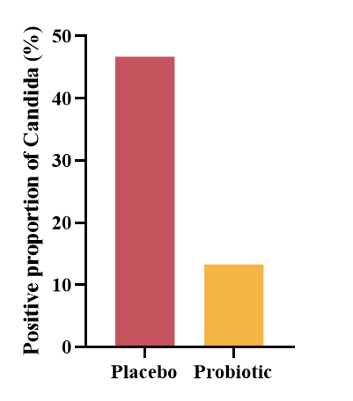
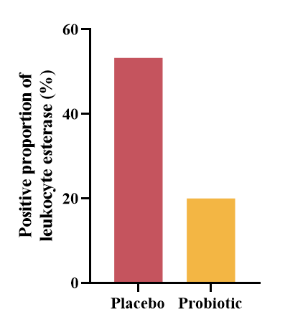
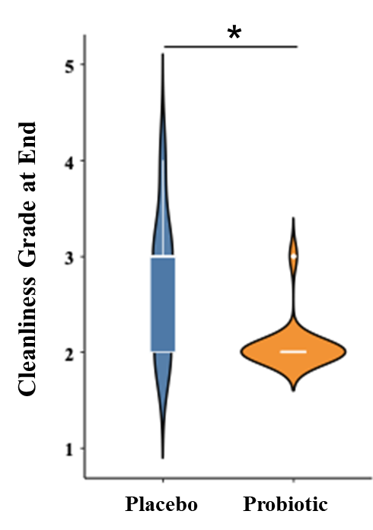
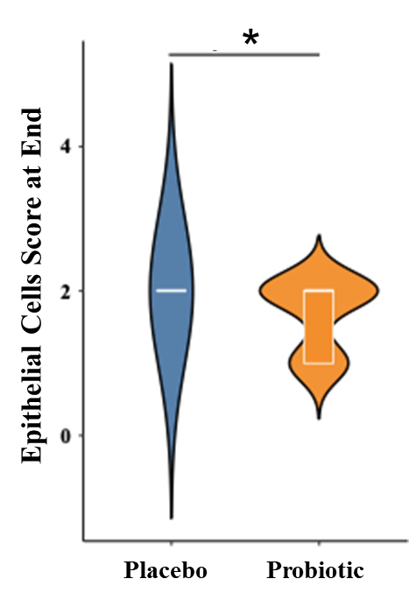
Solution
Improvement of vulvovaginal candidiasis
Reduces pathogen-associated biomarkers
Significantly improves vaginal cleanliness and epithelial integrity
Research Outcome
Reduced infections by pathogenic bacteria such as Candida and decreased leukocyte esterase positivity rates.
Improved vaginal cleanliness and epithelial integrity, and repaired the mucosal barrier.
Both Candida and leukocyte esterase positivity rates were decreased.
Vaginal cleanliness improved from Grade III-IV (infected state) to Grade I-II (healthy state). Vaginal epithelial exfoliation decreased and integrity increased.

Slide 14
Solution
Ovarian Function Protection and Support
Lacticaseibacillus rhamnosus LRa05; Lactobacillus crispatus LCr86;
Limosilactobacillus reuteri LR08; Bifidobacterium animalis subsp. lactis BLa80; Lactiplantibacillus plantarum Lp90; Weizmannia coagulans BC99
Key Excipients: Pomegranate Concentrate Powder;
Vitamin D3; Vitamin K2; Melon Powder
Other Excipients: Potato Starch
Functionality
Restores leptin sensitivity and improves metabolic signaling
Dual-target coordination of leptin and prolactin levels restores obesity-induced metabolic-reproductive endocrine dysregulation
Protects normal ovarian physiological rhythm
6 Strains
Optional Excipients
Powder / Capsule Form
Scientific Support
CLINICAL STUDIES
LRa05: NCT06821789 | LCr86: NCT06830122 | LRa05+LR08: NCT07013409
BLa80: NCT06107049 | Lp90: NCT06987279 | BC99: NCT06629441

Slide 15
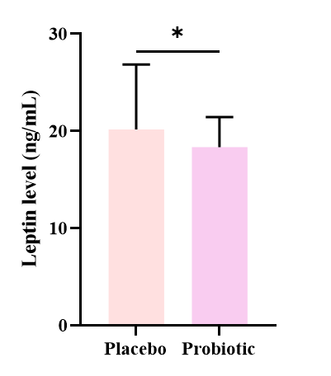
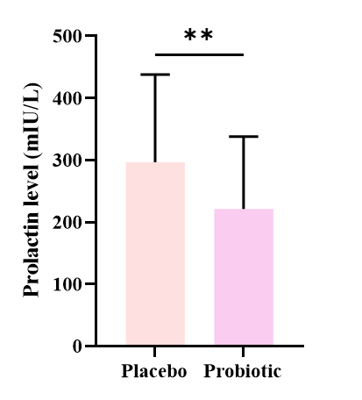
Solution
Ovarian Function Protection and Support
Research Outcome
Reduced leptin levels in obese women and help improve leptin sensitivity.
Reduced prolactin levels in obese women and promoted the restoration of normal ovarian biological rhythm.
Reduced leptin levels in obese women.
It indicated that probiotics help improve leptin sensitivity.
Significantly reduced prolactin levels in obese women.
It alleviated the suppression of the hypothalamic-pituitary-ovarian (HPO) axis through improvements in metabolism and the internal milieu.

Slide 16
Solution
Female Hormonal Balance Support
Lacticaseibacillus rhamnosus LRa05; Lactobacillus crispatus LCr86;
Limosilactobacillus reuteri LR08; Bifidobacterium breve BBr60;
Lactiplantibacillus plantarum Lp90; Weizmannia coagulans BC99
Key Excipients: Saffron Extract
Other Excipients: Inulin; Fructo-oligosaccharides;
Potato Starch
Functionality
Regulates the stress axis (ACTH) and improves the endocrine environment
Restores leptin sensitivity and optimizes the gonadotropin microenvironment
Promotes balance in the metabolic-stress-reproductive axis and systemically improves obesity-related endocrine disorders in women
6 Strains
Optional Excipients
Powder / Capsule Form
Scientific Support
CLINICAL STUDIES
LRa05+LR08: NCT07013409 | LCr86: NCT06830122 | BBr60: NCT06305650 NCT06196892
Lp90: NCT06987279 | BC99: NCT06077383 NCT06629441

Slide 17
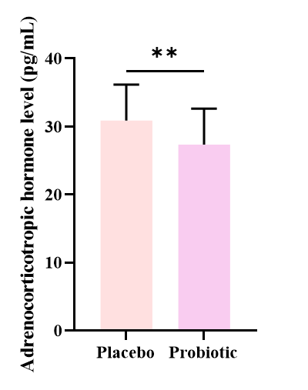


Solution
Female Hormonal Balance Support
Research Outcome
Regulated hormone levels such as prolactin and adrenocorticotropic hormone, and restored female reproductive endocrine rhythm.
Regulated leptin levels, improve leptin sensitivity, and optimize the gonadotropin secretory microenvironment.
Significantly reduced prolactin and adrenocorticotropic hormone (ACTH) levels in obese women.
It effectively alleviated the metabolic suppression of the hypothalamic-pituitary axis and restored female reproductive endocrine rhythm.
Reduced leptin levels in obese women.
It improved leptin sensitivity and optimized gonadotropin secretory microenvironment.

Slide 18
Solution
Female GLP-1 Regulation
Lacticaseibacillus rhamnosus LRa05; Lactobacillus crispatus LCr86;
Limosilactobacillus reuteri LR08; Bifidobacterium breve BBr60;
Lactiplantibacillus plantarum Lp90; Akkermansia muciniphila Akk11/pAkk11; Weizmannia coagulans BC99
Key Excipients: Astaxanthin Powder; Pomegranate Powder; Green Tea Powder
Other Excipients: Inulin; Potato Starch
Functionality
7 Strains
Modulates GLP-1 levels to help stabilize blood glucose balance
Improves body composition parameters and reduces body fat percentage
Modulates metabolism and improves energy efficiency
Optional Excipients
Powder / Capsule Form
Scientific Support
CLINICAL STUDIES
LRa05+LR08:NCT07013409 | LCr86: NCT06830122 | BBr60: NCT06305650
Lp90: NCT06987279 | Akk11: NCT06653101 | pAkk11: NCT06964932 NCT06964919
BC99: NCT06307821 NCT06629441

Slide 19
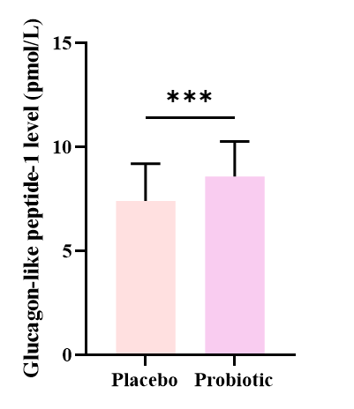
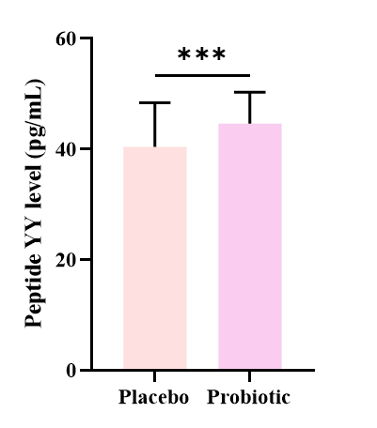
Solution
Female GLP-1 Regulation
The metabolic hormone GLP-1 was significantly elevated
The satiety hormone peptide YY (PYY) was significantly increased
Research Outcome
Glucagon-like peptide-1 (GLP-1) levels were significantly elevated, improving energy metabolism through the "gut-endocrine axis".
Peptide YY (PYY) levels were significantly elevated in obese women, enhancing physiological satiety signals and helping to reduce energy intake.
Significantly increased glucagon-like peptide-1 (GLP-1) levels in obese women.
Significantly increased peptide YY (PYY) levels in obese women.
It indicated that probiotics enhanced physiological satiety signaling and may contributed to reduce energy intake.
Partial data shown. More data available...

Slide 20
Solution
Anxiety and Depressive Mood Regulation
Lacticaseibacillus rhamnosus LRa05; Lactobacillus crispatus LCr86;
Limosilactobacillus reuteri LR08; Bifidobacterium breve BBr60;
Pediococcus acidilactici PA53; Lactiplantibacillus plantarum Lp90;
Weizmannia coagulans BC99
Key Excipients: Saffron Extract; Vitamin D3; Vitamin K2; Vitamin B6
Other Excipients: Inulin; Microcrystalline Cellulose
Functionality
7 Strains
Specifically improves anxiety and depressive states in the obese female population
Addresses concomitant emotional issues in obese women, achieving synergistic improvements in weight management and psychological health
Optional Excipients
Powder / Capsule Form
Scientific Support
CLINICAL STUDIES
LRa05+LR08: NCT07013409 | LCr86: NCT06830122 | BBr60: NCT06196892
PA53: NCT06648590 | Lp90: NCT06987279 | BC99: NCT06629441

Slide 21

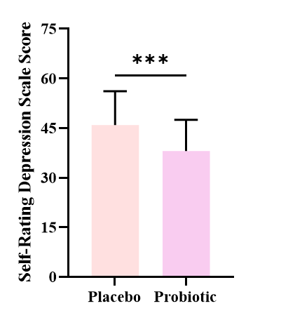
Solution
Anxiety and Depressive Mood Regulation
Alleviate anxiety symptoms
Alleviate depressive symptoms
Research Outcome
Anxiety self-rating scale scores were significantly reduced in obese women, effectively improving anxiety status.
Depression self-rating scale scores were significantly reduced in obese women, effectively improving depressive status.
Significantly reduced anxiety self-rating scale scores in obese women.
Significantly reduced depression self-rating scale scores in obese women.

Slide 22

WecPro®-Mental Health
Designed specifically for mental health
Helps manage stress and mood, improves sleep quality, and supports relief of anxiety and depressive symptoms.
Solutions
Sleep Quality Improvement
Attention and Behavioral Regulation
Anxiety and Depressive Mood Regulation
Stress State Alleviation
12+
Clinical Studies
BLa80
Bifidobacterium animalis subsp. lactis
LRa05
Lacticaseibacillus rhamnosus
BBr60
Bifidobacterium
breve

Slide 23
Solution
Sleep Quality Improvement
Bifidobacterium animalis subsp. lactis BLa80; Lacticaseibacillus rhamnosus LRa05;
Bifidobacterium breve BBr60; Bifidobacterium longum subsp. longum BL21; Bifidobacterium adolescentis BAC30; Bifidobacterium longum subsp. infantis BI45; Weizmannia coagulans BC99
Key Excipients: Melatonin; L-Theanine; Gamma-Aminobutyric Acid; Magnolia Bark Powder;Ashwagandha Powder
Other Excipients: Inulin; Fructo-oligosaccharides; Potato Starch
Functionality
7 Strains
Significantly improves anxiety and depressive mood
Shortens sleep onset time and enhances sleep quality
Increases life quality and satisfaction
Optional Excipients
Powder / Capsule Form
Scientific Support
CLINICAL STUDIES
BLa80: NCT06107049 | LRa05:NCT06821789
BBr60: NCT06196892 | BC99: NCT06629441
BLa80+BL21+BBr60+BAC30+BI45: NCT06847919

Slide 24
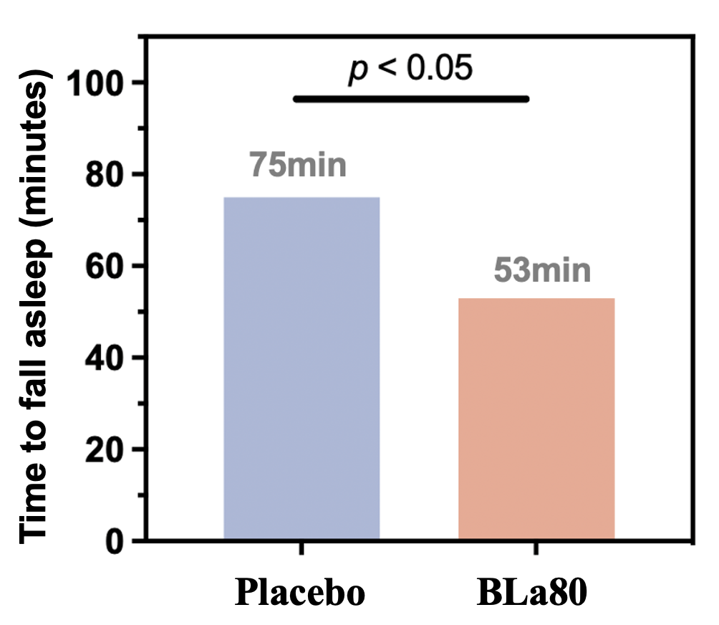
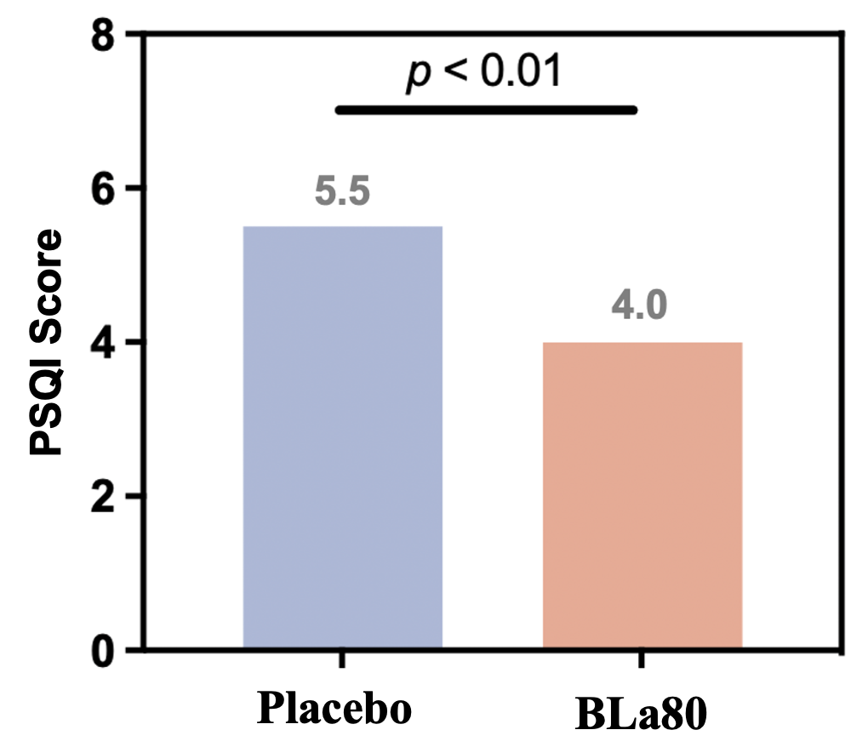
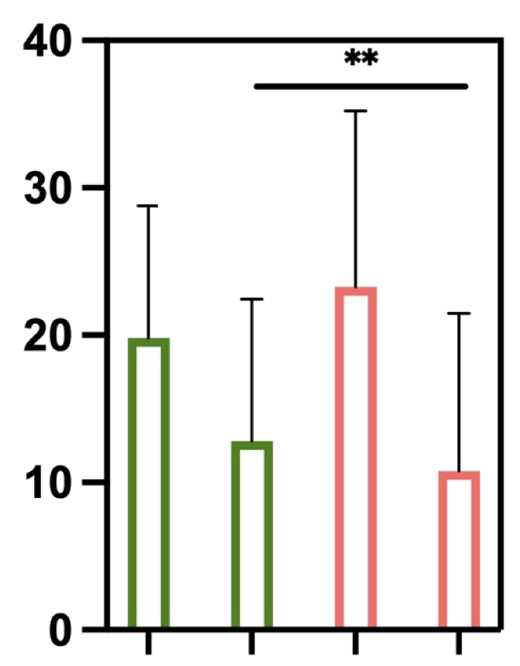
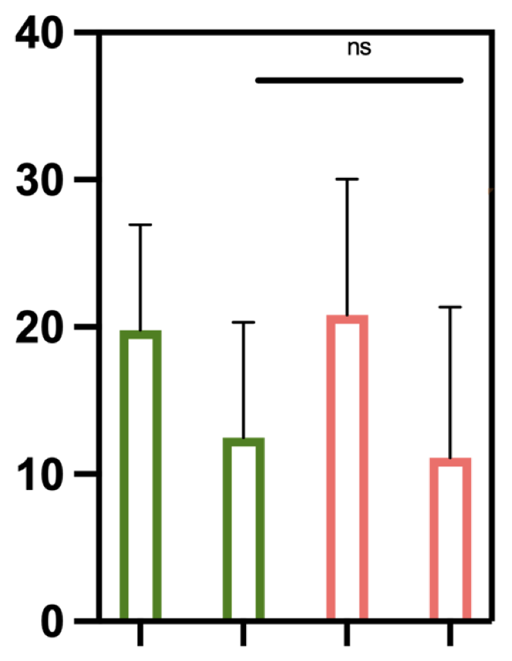
Solution
Sleep Quality Improvement
8 weeks
Improves sleep quality
Probiotic intervention group exhibited an average 22-minute reduction in sleep onset time and a 1.5-point decrease in sleep quality scores.
Research Outcome
Probiotic intervention shortened sleep onset time, improved sleep quality, and promoted better sleep.
Both HAMA and HAMD scores decreased, helping alleviate anxiety and depressive mood.
8 weeks
Alleviates anxiety and depression
Probiotic intervention significantly alleviated anxiety and depressive symptoms in adults, with HAMA and HAMD scores reduced by 12.5 and 9.7 points respectively.
HAMA-14 Score
HAMD-17 Score
DOI: 10.1038/s41598-025-95208-2
DOI: 10.3390/nu17193087
BC99_end
Placebo_end
BC99_end
Placebo_end
BC99_baseline
Placebo_baseline
BC99_baseline
Placebo_baseline

Slide 25
Solution
Attention and Behavioral Regulation
Bifidobacterium animalis subsp. lactis BLa80; Lacticaseibacillus rhamnosus LRa05;
Bifidobacterium breve BBr60; Pediococcus acidilactici PA53;
Lactiplantibacillus plantarum Lp90; Weizmannia coagulans BC99
Key Excipients: Bacopa monnieri Extract; Vitamin B6;Sialic Acid
Other Excipients: Fructo-oligosaccharides; Potato Starch
Functionality
6 Strains
Alleviates symptoms of attention deficit
Reduces manifestations of hyperactivity and impulsivity
Improves executive function and emotional regulation
Optional Excipients
Powder / Capsule Form
Scientific Support
CLINICAL STUDIES
BLa80+LRa05: NCT06348121 | BBr60: NCT06196892
PA53: NCT06648590 | Lp90: NCT06987279
BC99: NCT06676111

Slide 26
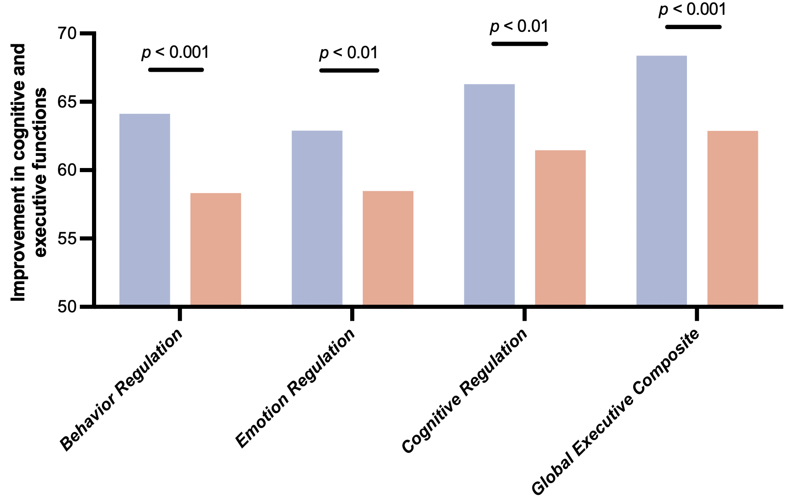
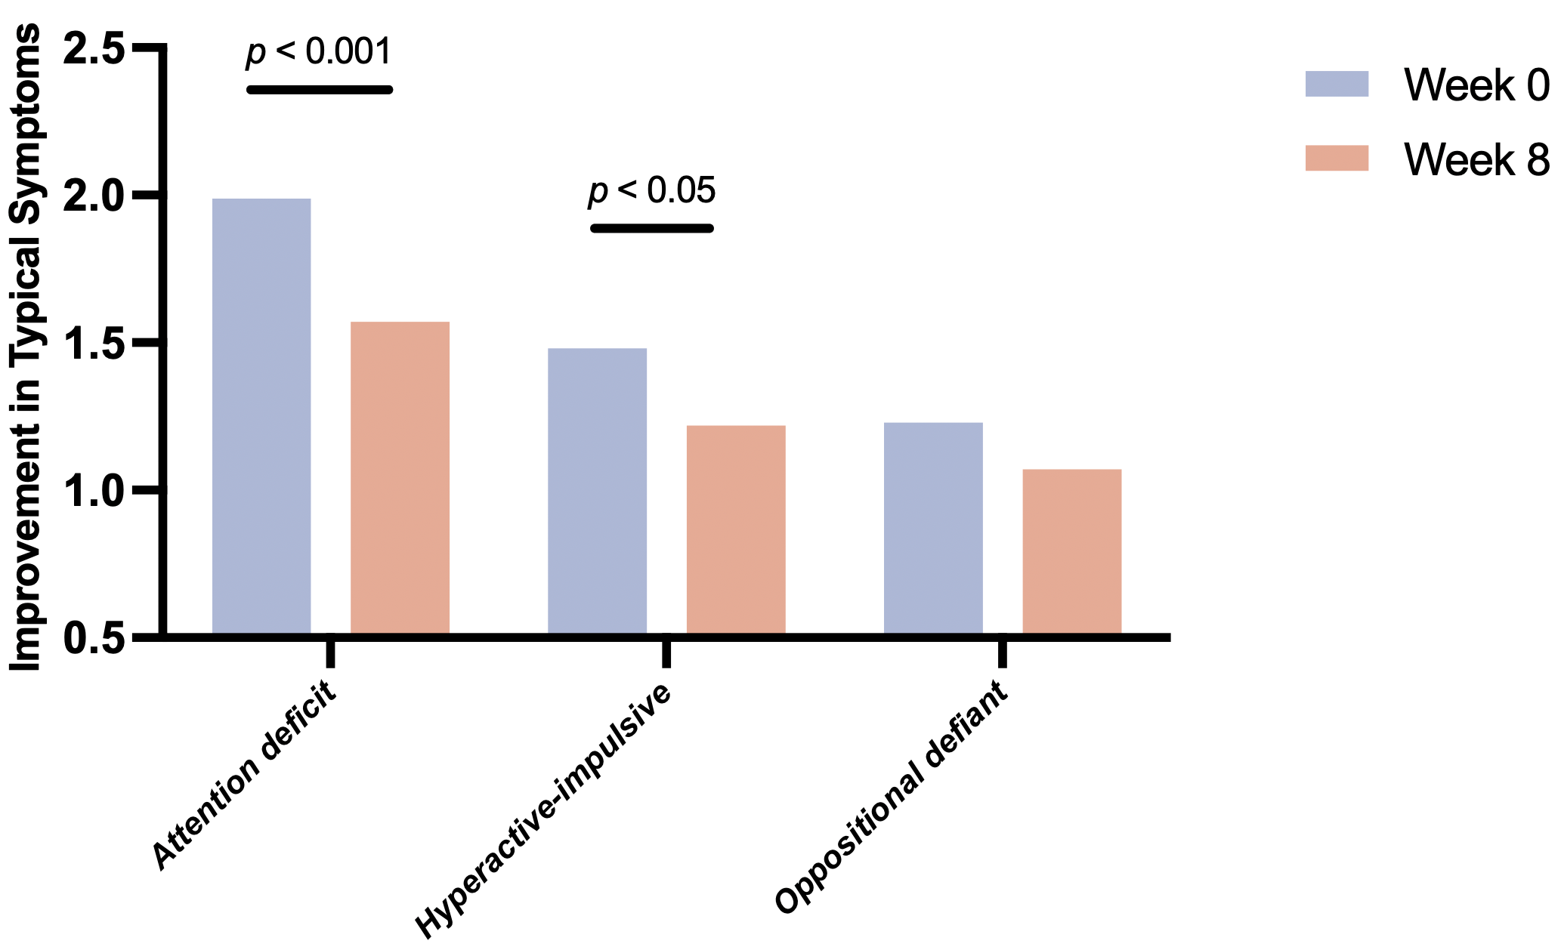
Solution
Attention and Behavioral Regulation
Research Outcome
Significantly improved cognitive and executive functions, aiding in the enhancement of emotional regulation, behavioral management, and cognitive modulation abilities.
Improved core ADHD symptoms such as attention deficit, hyperactivity, and impulsive behaviors.
Improve cognitive and executive function
Improve typical ADHD symptoms
After 8 weeks of probiotic intervention, subjects showed notable improvements in cognitive and executive function.
Their capacities for emotional regulation, behavioral management, and cognitive modulation were also significantly boosted.
Following an 8-week probiotic intervention, subjects demonstrated a significant reduction in core ADHD symptoms.
Specifically, their attention deficits were improved, and hyperactivity and impulsive behaviors were effectively alleviated.
DOI: 10.1002/mnfr.70234

Slide 27
Solution
Anxiety and Depressive Mood Regulation
Bifidobacterium animalis subsp. lactis BLa80; Lacticaseibacillus rhamnosus LRa05;
Bifidobacterium breve BBr60; Pediococcus acidilactici PA53;
Limosilactobacillus reuteri LR08; Weizmannia coagulans BC99
Key Excipients: Ashwagandha Powder (Withania somnifera); L-Theanine; Gamma-Aminobutyric Acid (GABA); Resveratrol
Other Excipients: Inulin; Potato Starch
Functionality
6 Strains
Alleviates symptoms associated with depression and anxiety.
Modulates inflammatory cytokine levels and improves immune-inflammatory status.
Regulates neurotransmitter levels and supports neurofunctional balance.
Optional Excipients
Powder / Capsule Form
Scientific Support
CLINICAL STUDIES
BLa80+LRa05: NCT06216587 | LRa05: NCT06821789
BBr60: NCT06196892 | PA53: NCT06648590
BC99: NCT06629441 | LRa05+LR08: NCT07013409

Slide 28
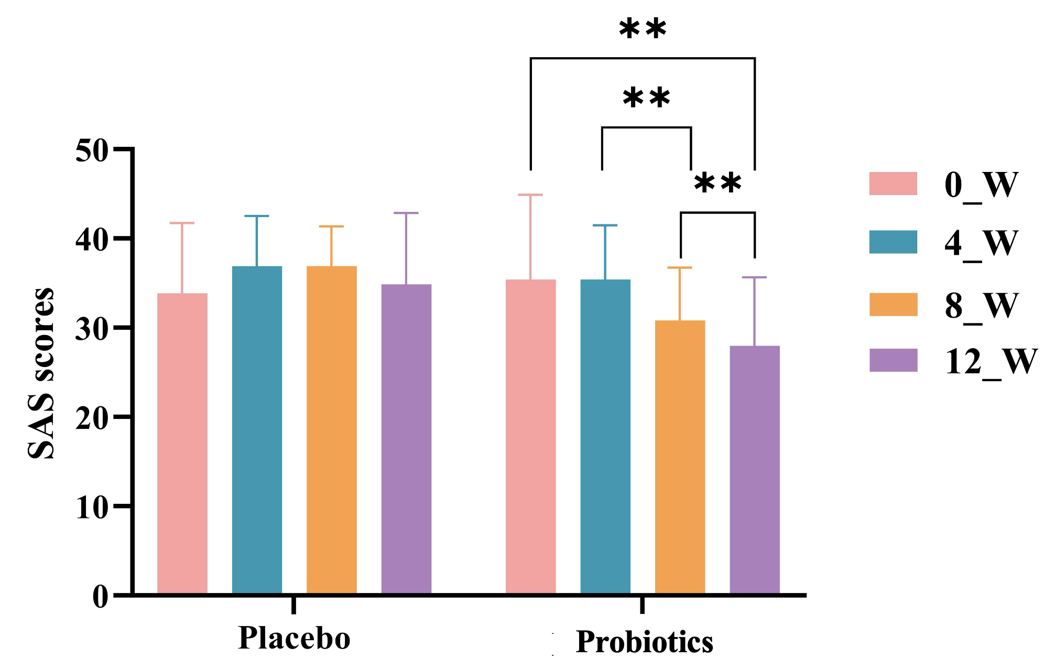
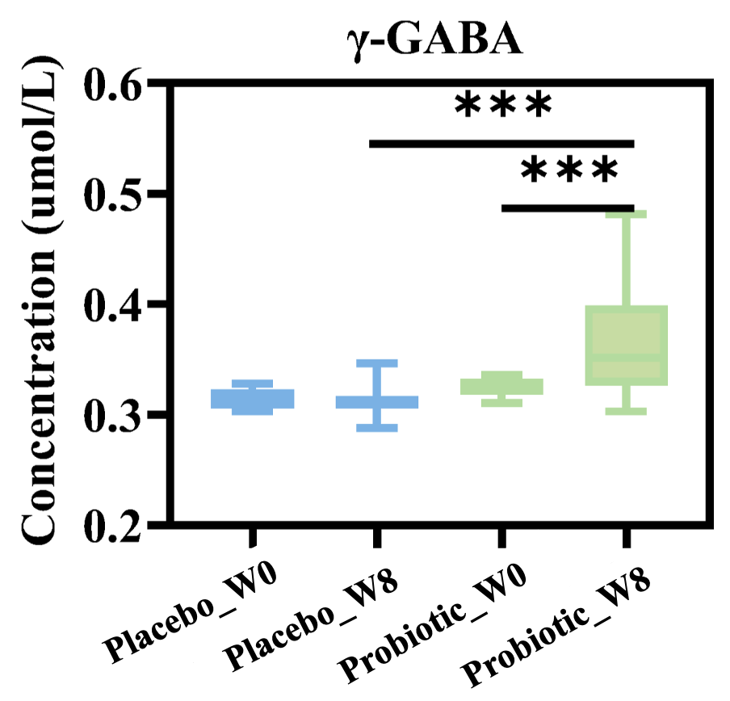
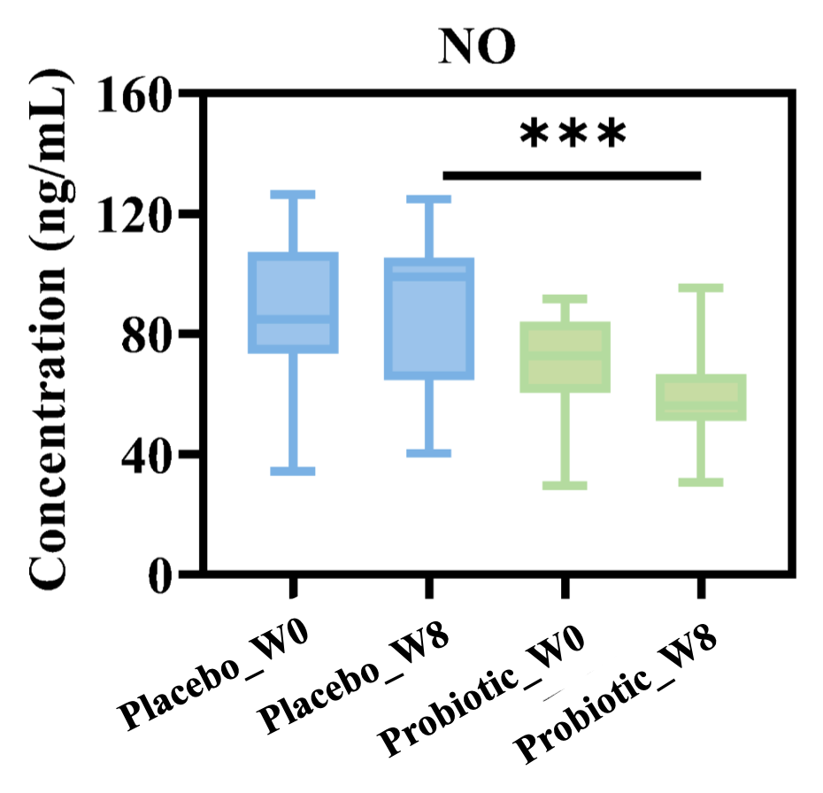
Solution
Anxiety and Depressive Mood Regulation
Research Outcome
Reduce anxiety and depression levels
Regulate neurotransmitter levels
SAS scores decreased with the duration of probiotic intervention, aiding in the alleviation of anxiety symptoms.
Significantly increased γ-GABA levels and reduced nitric oxide (NO) content, positively influence anxiety and depressive mood by modulating neurotransmitter and related signaling molecule levels.
Probiotic intervention induced a significant, progressive SAS score decrease vs. the placebo group (no significant changes at any time point).
Following 8 weeks of probiotic intervention, a significant increase in γ-GABA levels and a notable reduction in nitric oxide (NO) content were observed.
DOI: 10.3390/nu17193087
DOI: 10.1163/18762891-bja00083

Slide 29
Solution
Stress State Alleviation
Bifidobacterium animalis subsp. lactis BLa80; Lacticaseibacillus rhamnosus LRa05;
Bifidobacterium breve BBr60; Pediococcus acidilactici PA53;
Bifidobacterium longum subsp. longum BL21; Weizmannia coagulans BC99
Key Excipients: Ashwagandha Powder (Withania somnifera); L-Theanine; Vitamin B6; Coenzyme Q10
Other Excipients: Fructo-oligosaccharides; Potato Starch
Functionality
6 Strains
Supports emotional balance and psychological well-being under stress
Helps regulate inflammation associated with physiological stress responses
Supports stress-related brain–gut communication and signaling pathways
Optional Excipients
Powder / Capsule Form
Scientific Support
CLINICAL STUDIES
BLa80+LRa05: NCT06216587 | LRa05: NCT06821789
BBr60: NCT06196892 | PA53: NCT06648590
BL21: NCT06544278 | BC99: NCT06629441

Slide 30
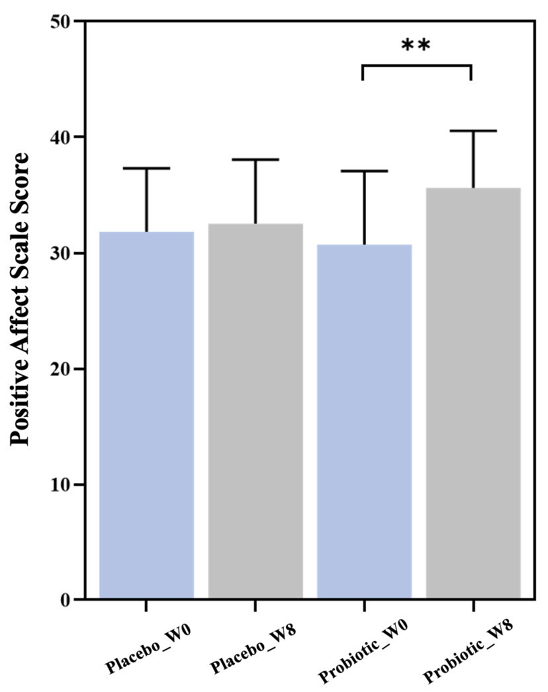
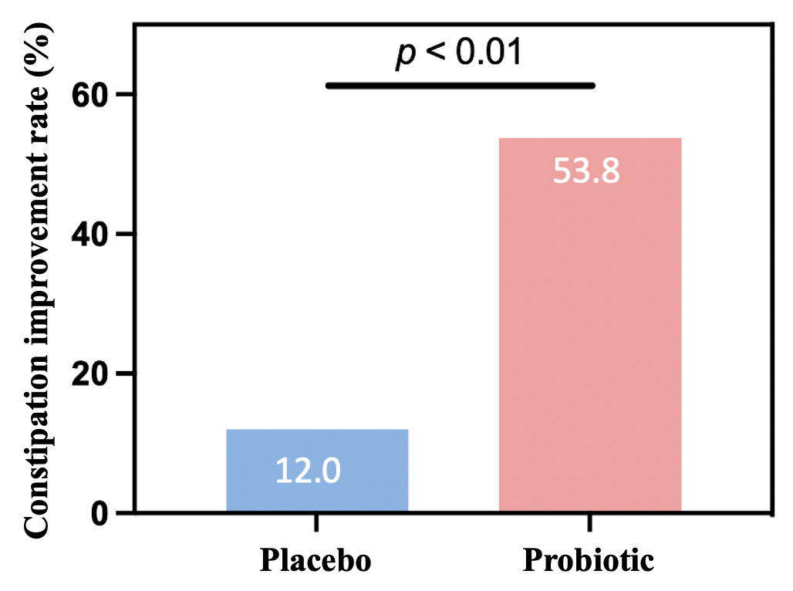
Solution
Stress State Alleviation
Research Outcome
Positive Emotion Scale scores increased significantly, improved positive emotional states and alleviate stress levels.
Anxiety and depressive symptoms decreased markedly, with notable improvements in emotional well-being and greater emotional stability.
Improve mood
Stress relief level
After 8-week probiotic intervention, positive Emotion Scale scores increased significantly, with a 4.92-point rise vs. baseline.
After 8-week probiotic intervention, HAMA-14 score was significantly reduced from 23.27 to 10.77, indicating a marked decrease in anxiety levels.
DOI: 10.1016/j.clnu.2025.07.004
DOI: 10.3390/nu17193087

Slide 31


WecPro®-Metabolic Health
Designed specifically for metabolic health
Supports metabolic balance and weight management, including healthier control of blood glucose, lipids, and blood pressure.
Solutions
Relief of Alcohol-Related Discomfort
Body Management and Muscle Support
Uric Acid Metabolism Regulation
Blood Pressure Homeostasis Support
Integrated Management of Hypertension,
Hyperglycemia, and Hyperlipidemia
Lipid Homeostasis Regulation
Weight Management and Metabolic Balance
Sports Nutrition and Physical Performance Support
Liver Protection and Metabolic Support
Anti-Aging and Functional Maintenance
Glycemic Homeostasis Regulation
GLP-1 Functional Modulation
29+
Clinical Studies
BL21
Bifidobacterium longum
subsp. longum
LRa05
Lacticaseibacillus rhamnosus
BBr60
Bifidobacterium
breve

Slide 32
Solution
Weight Management and Metabolic Balance
Bifidobacterium breve BBr60; Lacticaseibacillus rhamnosus LRa05;
Bifidobacterium longum subsp. longum BL21; Lactiplantibacillus plantarum Lp90;
Limosilactobacillus reuteri LR08; Weizmannia coagulans BC99
Key Excipients: Green Tea Powder; Blood Orange Concentrate Powder
Other Excipients: Inulin; Acacia Gum; Potato Starch
Functionality
6 Strains
Improves energy metabolism efficiency
Supports weight management
Aids in fat reduction
Optional Excipients
Powder / Capsule Form
Scientific Support
CLINICAL STUDIES
BBr60:NCT06305650 | LRa05:NCT06821789
BL21:NCT06140641 | Lp90:NCT06987279
LRa05+LR08:NCT07013409 | BC99:NCT06077383

Slide 33
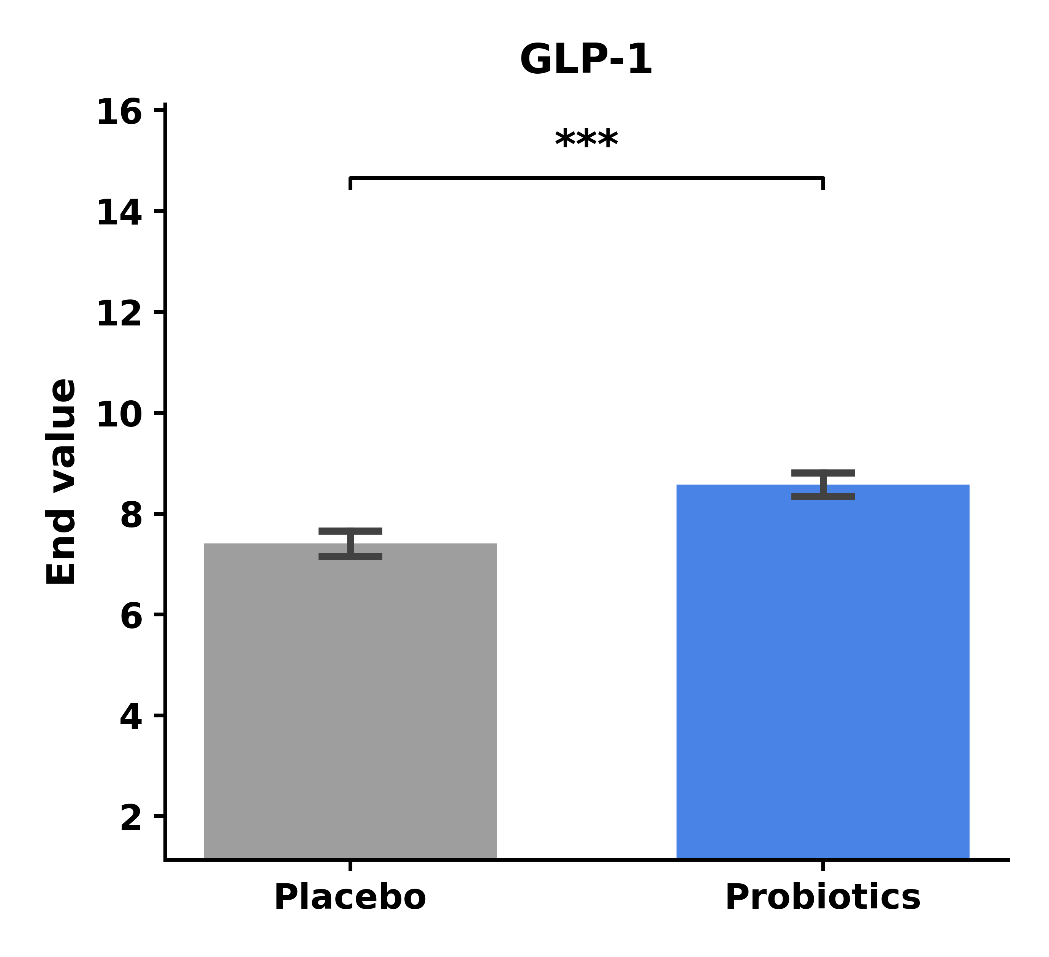
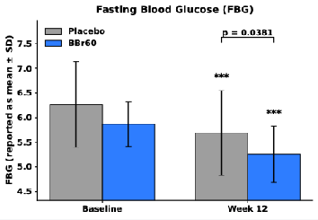
Solution
Weight Management and Metabolic Balance
12 weeks
Research Outcome
Supported healthy weight management by promoting weight reduction and stability.
Modulated gut microecology and key metabolic pathways to enhance energy metabolism efficiency.
Maintained homeostasis of blood glucose, blood lipids, and inflammation-related indicators.
Modulated GLP-1 levels to support long-term metabolic health and reduce the risk of metabolic disturbances.
Placebo Probiotics
Placebo Probiotics
Placebo Probiotics
The probiotic group exhibited greater weight loss.
The probiotic group showed a more significant decrease in fat mass and increase in fat-free mass.
12 weeks
The probiotic group showed significantly higher GLP-1 levels.
Probiotic group exhibited lower fasting blood glucose (FBG) levels (Week 12: 5.26 ± 0.57 vs 5.69 ± 0.86, between-group p = 0.0381), improving glycemic homeostasis.
DOI: 10.3390/ijms252010871
DOI: 10.3390/nu16233990
*GLP-1 (Glucagon-like peptide-1): A gut-derived incretin hormone secreted by intestinal L-cells, which plays a key role in blood glucose regulation, energy balance, and metabolic control.

Slide 34
Solution
Sports Nutrition and Physical Performance Support
Bifidobacterium breve BBr60; Lacticaseibacillus rhamnosus LRa05;
Bifidobacterium longum subsp. longum BL21; Bifidobacterium animalis subsp. lactis BLa80;
Akkermansia muciniphila Akk11/pAkk11; Weizmannia coagulans BC99
Key Excipients: Vitamin B6; Vitamin K2;
Black Pepper Extract
Other Excipients: Resistant Dextrin;
Fructo-oligosaccharides; Potato Starch
Functionality
6 Strains
Enhances nutrient metabolism efficiency
Supports physical performance and endurance enhancement
Promotes post-exercise recovery
Optional Excipients
Powder / Capsule Form
Scientific Support
CLINICAL STUDIES
BBr60: NCT06305650 NCT06196892 | LRa05: ChiCTR2300073308 NCT06901791
BL21: NCT06140641 | BLa80: ChiCTR2300073412
Akk11: NCT06653101 | pAkk11: NCT06964932 NCT06964919
BC99: NCT06307821

Slide 35
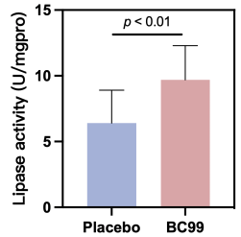
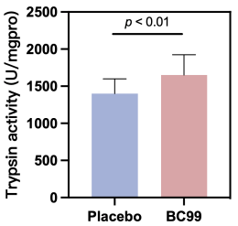
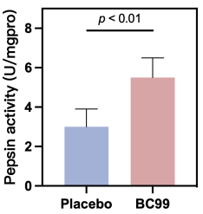
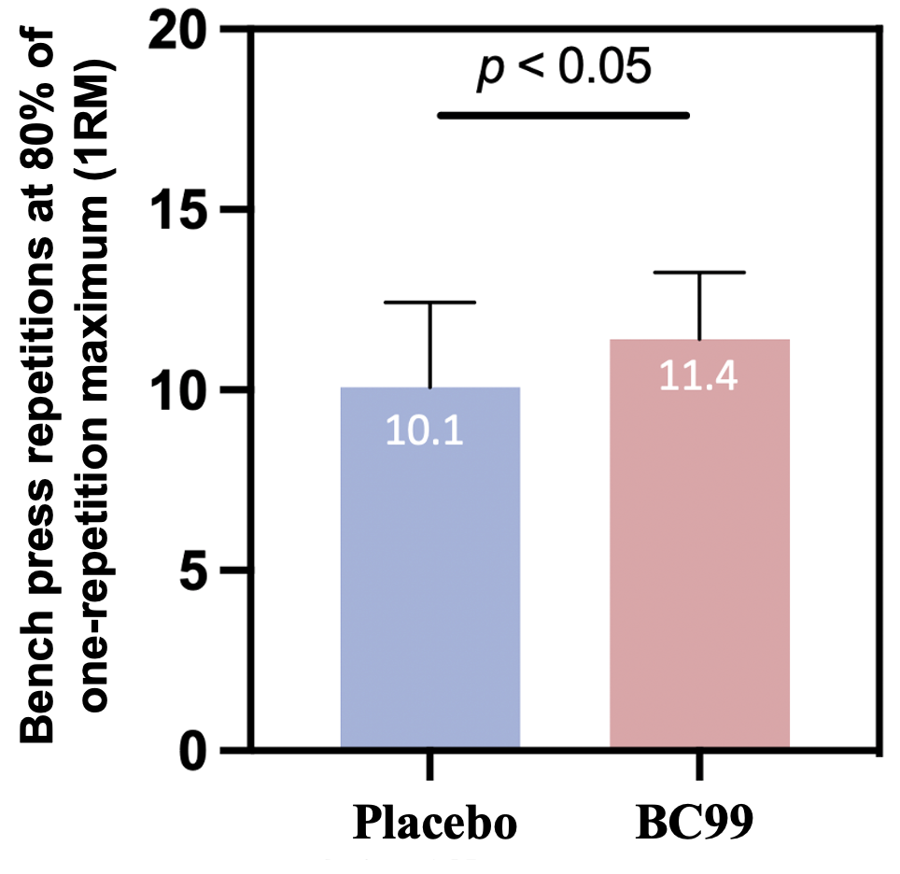
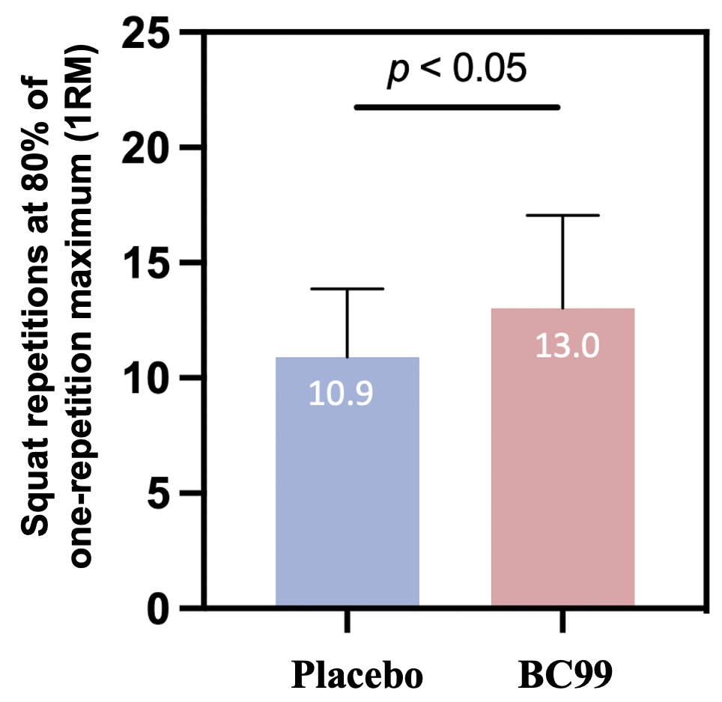
Solution
Sports Nutrition and Physical Performance Support
12 weeks
BC99 group showed significantly increased digestive enzyme activity, suggesting that BC99 may enhance physical performance and muscle synthesis by improving protein digestion and absorption efficiency.
Research Outcome
+83.3%
+17.8%
Optimized gut micro-ecology and nutrient utilization to support efficient energy metabolism during exercise
Enhanced metabolic adaptation, fatigue resistance, and protection against exercise-induced metabolic and oxidative stress
Supported muscle function, and efficient post-exercise recovery to improve endurance performance
+51.6%
Placebo Probiotics
Placebo Probiotics
Placebo Probiotics
12 weeks
Athletes in BC99 intervention group increased times of repetitions at 80% of one-rep max (1RM) by 1.3 times in the bench press and by 2.1 times in the squat.
+1.3
+2.1
DOI: 10.3390/nu16233990
Placebo Probiotics
Placebo Probiotics

Slide 36
Solution
Liver Protection and Metabolic Support
Bifidobacterium breve BBr60; Lacticaseibacillus rhamnosus LRa05;
Bifidobacterium longum subsp. longum BL21;
Bifidobacterium animalis subsp. lactis BLa80; Weizmannia coagulans BC179;
Akkermansia muciniphila Akk11/pAkk11; Weizmannia coagulans BC99
Key Excipients: Turmeric Powder; Milk Thistle Extract
Other Excipients: Fructo-oligosaccharides; Inulin; Potato Starch
Functionality
7 Strains
Accelerates ethanol and acetaldehyde metabolism
Modulates liver function‑related indicators
Reduces oxidative stress damage
Optional Excipients
Powder / Capsule Form
Scientific Support
CLINICAL STUDIES
BLa80+LRa05+BC99+BC179: ChiCTR2400082180 | BLa80+LRa05: NCT06216587
BL21: NCT06544278 | BBr60: NCT06196892
BC99: NCT06607562 | BC179: NCT06899620
Akk11: NCT06780007 | pAkk11: NCT06964932 NCT06964919

Slide 37
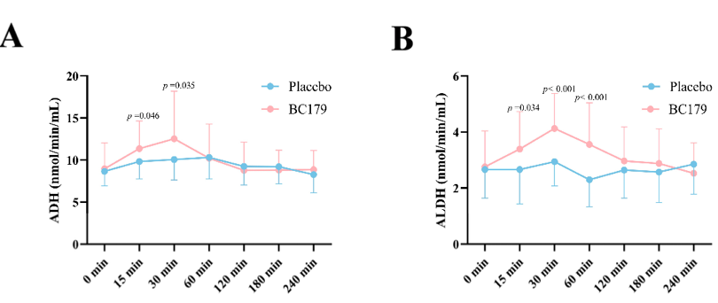
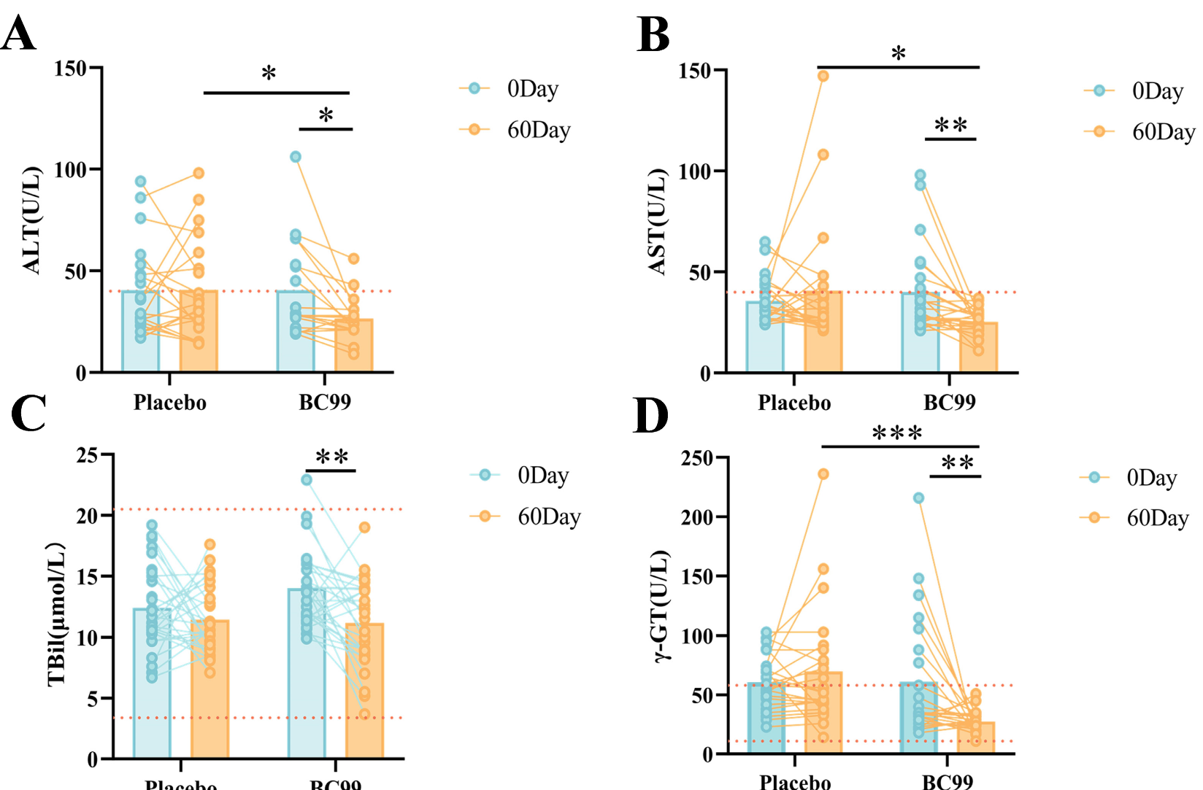
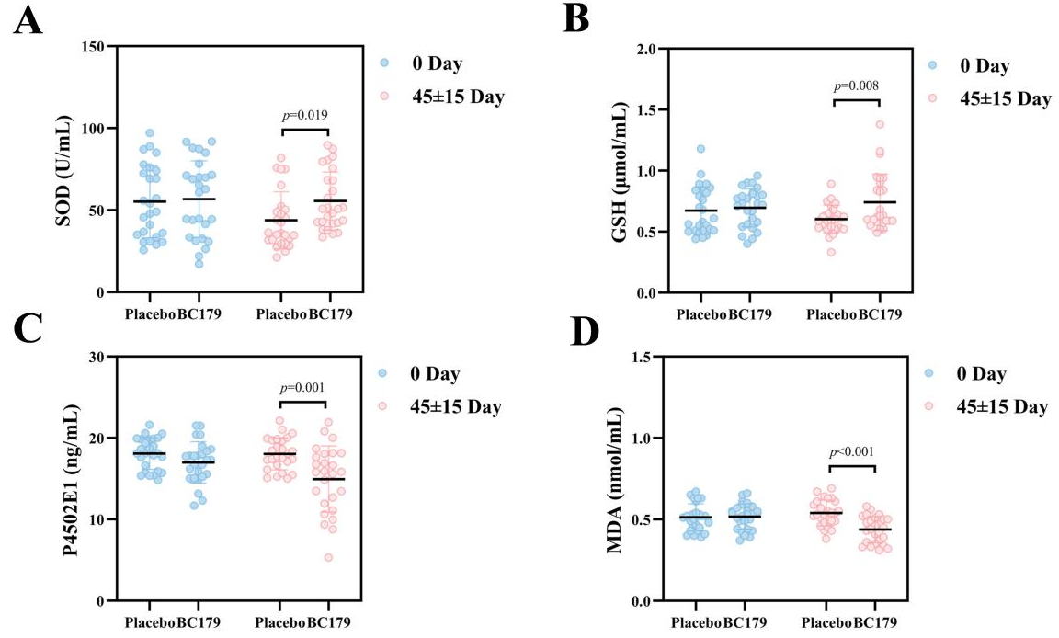
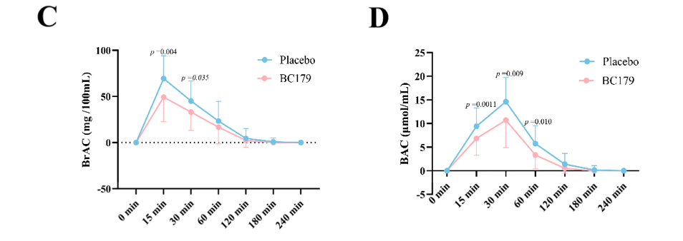
Solution
Liver Protection and Metabolic Support
Research Outcome
30 days
30 days
2 months
Balanced blood glucose, blood lipids, and inflammatory markers
Supported evidence-based weight management by enhancing metabolic adaptability
Modulated gut micro-ecology and liver–metabolism pathways to improve energy and lipid metabolism efficiency
Promoted liver function and overall metabolic health, reducing the risk of metabolic disorders
Probiotic
Probiotic
Probiotic
Probiotic
Probiotic
Placebo Probiotic Placebo Probiotic
Placebo Probiotic Placebo Probiotic
Probiotic
Probiotic
12周
Placebo Probiotic Placebo Probiotic
Placebo Probiotic Placebo Probiotic
Placebo
Probiotic
Placebo
Probiotic
12周
Probiotic significantly increased the activity of ADH and ALDH enzymes after alcohol consumption, thereby accelerating the metabolism of ethanol and acetaldehyde. It also significantly reduced breath and blood alcohol concentrations at 15 and 30 minutes after drinking.
BC179 intervention significantly reduced MDA levels after alcohol consumption (p < 0.001).
After two months of intervention, all four liver function markers — ALT, AST, TBil, and γ-GT — showed significant decreases. Notably, the rates of abnormal AST and γ-GT levels, which were 34.78% and 30.43% respectively before intervention, dropped to 0%.
DOI: 10.3390/nu17020320
DOI: 10.3390/antiox14091038

Slide 38
Solution
Anti-Aging and Functional Maintenance
Bifidobacterium breve BBr60; Lacticaseibacillus rhamnosus LRa05;
Bifidobacterium longum subsp. longum BL21;
Bifidobacterium animalis subsp. lactis BLa80; Weizmannia coagulans BC99; Lactobacillus acidophilus LA85; Lacticaseibacillus paracasei LC86;
Pediococcus acidilactici PA53; Lactiplantibacillus plantarum Lp05
Key Excipients: Haematococcus pluvialis Powder; Pomegranate Concentrate Powder; Resveratrol
Other Excipients: Inulin; Potato Starch
Functionality
9 Strains
Regulates oxidative stress status
Improves physical fitness
Promotes nutrient absorption and muscle synthesis
Optional Excipients
Powder / Capsule Form
Scientific Support
CLINICAL STUDIES
BLa80+LRa05+BC99+BL21+LA85+LC86+BBr60+PA53+Lp05: NCT06781814 NCT07025798

Slide 39
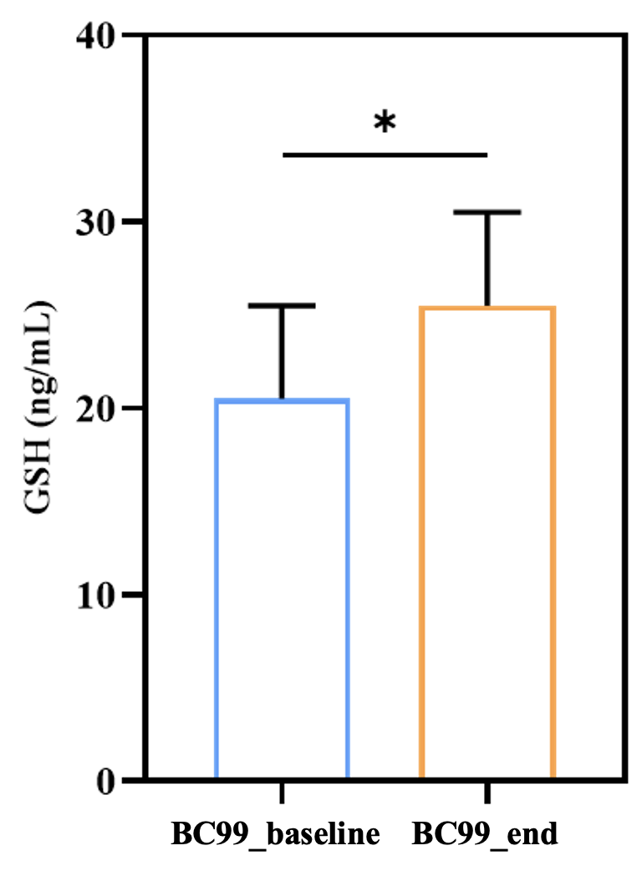
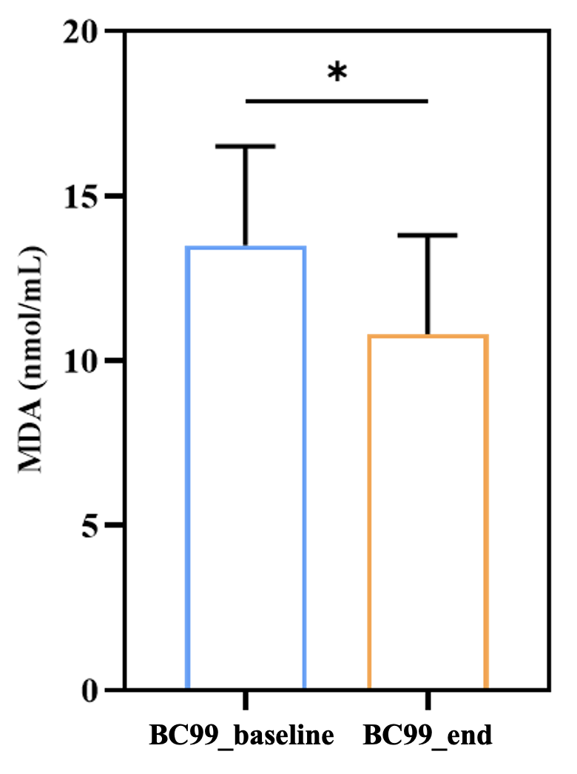


Solution
Anti-Aging and Functional Maintenance
8 weeks
8 weeks
Research Outcome
Improve oxidative stress
Enhance strength capacity
Modulated oxidative stress status and reduced oxidative damage
Promoted nutrient absorption and supported muscle protein synthesis
Significantly enhanced physical performance and overall fitness
Probiotic_baseline Probiotic_end
Probiotic_baseline Probiotic_end
Placebo Probiotic
Placebo Probiotic
BC99 intervention group showed a significant increase in the antioxidant marker glutathione (GSH) and a significant decrease in the oxidative damage marker malondialdehyde (MDA).
BC99 intervention group demonstrated significant improvements in strength endurance performance. The times of repetitions at 80% of one-repetition maximum (1RM) increased by 1.3 repetitions (+12.9%) in the bench press and by 2.1 (+19.3%) in the squat.
DOI: 10.3389/fimmu.2025.1654724
DOI: 10.3390/nu16233990

Slide 40
Solution
Glycemic Homeostasis Regulation
Bifidobacterium breve BBr60; Lacticaseibacillus rhamnosus LRa05;
Bifidobacterium longum subsp. longum BL21; Bifidobacterium animalis subsp. lactis BLa80;
pasteurized Akkermansia muciniphila pAkk11; Weizmannia coagulans BC99
Key Excipients: Green Tea Powder; Edible Mushroom Concentrate Powder (Agaricus bisporus)
Other Excipients: Inulin; Acacia Gum; Potato Starch
Functionality
6 Strains
Improves insulin sensitivity
Significantly reduces fasting blood glucose
Improves lipid and glucose metabolism
Optional Excipients
Powder / Capsule Form
Scientific Support
CLINICAL STUDIES
LRa05: ChiCTR2300073308 NCT06901791 | BBr60: NCT06305650
BL21: ChiCTR2300073299 | BLa80: ChiCTR2300073412
BLa80+LRa05+BBr60: NCT06440486 | pAkk11: NCT06964932 NCT06964919
BC99: NCT06307821

Slide 41
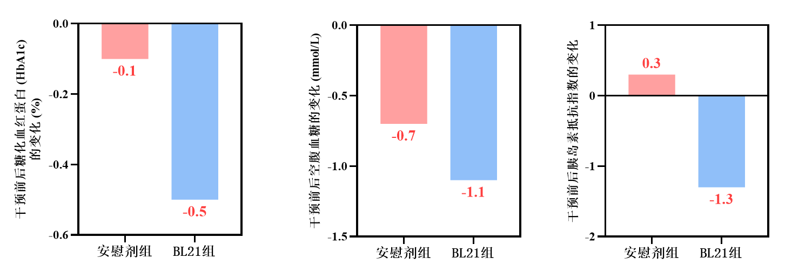
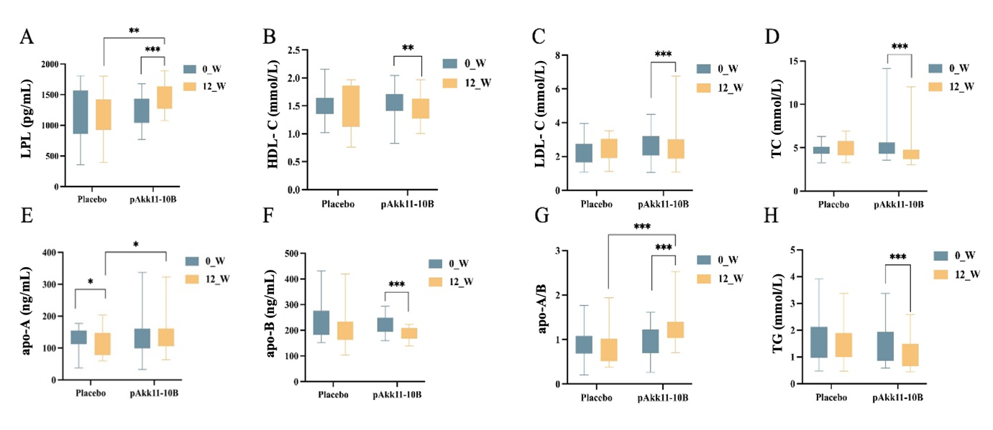
Solution
Glycemic Homeostasis Regulation
12 weeks
Blood glucose level Improvement in patients with Type II diabetes
Research Outcome
Significantly reduced serum insulin, fasting blood glucose and glycated hemoglobin levels
Improved insulin sensitivity and long-term glycemic control in Type II diabetes patients
Enhanced lipid metabolism, lowering total cholesterol and triglycerides, boosted beneficial LPL activity to reduce atherosclerosis risk
Supported healthy glucose metabolic homeostasis and overall metabolic balance
Change in glycated hemoglobin (HbA1c) (%)
Change in fasting blood glucose (mmol/L)
Change in insulin resistance index
Placebo
Probiotic
Placebo
Probiotic
Placebo
Probiotic
12 weeks
Lipid Metabolism and Cardiovascular Risk Improvement
Placebo Probiotic
Placebo Probiotic
Placebo Probiotic
Placebo Probiotic
DOI：10.4239/wjd.v16.i7.106821
Placebo Probiotic
Placebo Probiotic
Placebo Probiotic
Placebo Probiotic

Slide 42
Solution
GLP-1 Functional Modulation
Bifidobacterium breve BBr60; Lacticaseibacillus rhamnosus LRa05;
Bifidobacterium longum subsp. longum BL21;
Lactiplantibacillus plantarum Lp90; Limosilactobacillus reuteri LR08;
Akkermansia muciniphila Akk11/pAkk11; Weizmannia coagulans BC99
Key Excipients: Green Tea Powder; Vitamin B6; Black Pepper Extract (Piper nigrum)
Other Excipients: Inulin; Acacia Gum; Potato Starch
Functionality
Enhances GLP-1 levels to regulate appetite and glucose control
Optimizes lipid metabolism to support cardiovascular health
Balances overall metabolic functions and activates intrinsic health-maintaining mechanisms
7 Strains
Optional Excipients
Powder / Capsule Form
Scientific Support
CLINICAL STUDIES
LRa05+LR08: NCT07013409 | BBr60: NCT06305650
BL21: ChiCTR2300073299 | Lp90: NCT06987279
pAkk11: NCT06964932 NCT06964919 | Akk11: NCT06653101
BC99: NCT06307821

Slide 43
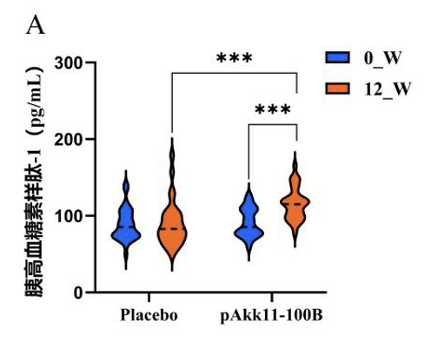
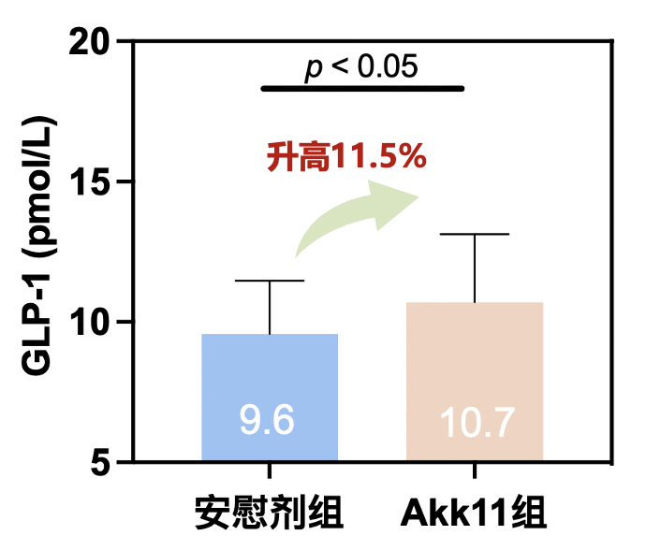
Solution
GLP-1 Functional Modulation
Increase GLP-1 Levels
Research Outcome
12 weeks
8 weeks
Increased GLP-1 levels to regulate appetite and glucose metabolism
Improved lipid metabolism to support cardiovascular health
Balanced metabolic functions and activated intrinsic health-regulating pathways
GLP-1 (pg/mL）
Placebo
Probiotic
Placebo
Probiotic
Probiotic demonstrated a significant increase in GLP-1 after 12 weeks of intervention.
Probiotic increased plasma GLP‑1 levels to 10.7 pmol/L, compared with 9.6 pmol/L in the placebo group.

Slide 44
Solution
Relief of Alcohol-Related Discomfort
Bifidobacterium breve BBr60; Lacticaseibacillus rhamnosus LRa05;
Bifidobacterium longum subsp. longum BL21; Bifidobacterium animalis subsp. lactis BLa80;
Weizmannia coagulans BC179; Weizmannia coagulans BC99
Key Excipients: Rice Bran Fatty Alcohols; Milk Thistle Extract;
Other Excipients: Inulin; Potato Starch
Functionality
6 Strains
Accelerates alcohol and acetaldehyde metabolism
Rapidly reduces blood alcohol concentration
Improves short-term cognitive performance
Optional Excipients
Powder / Capsule Form
Scientific Support
CLINICAL STUDIES
BLa80+LRa05+BC99+BC179: ChiCTR2400082180 | BBr60: NCT06196892
BL21: NCT06544278 | BC179: NCT06899620
BC99: NCT06607562

Slide 45
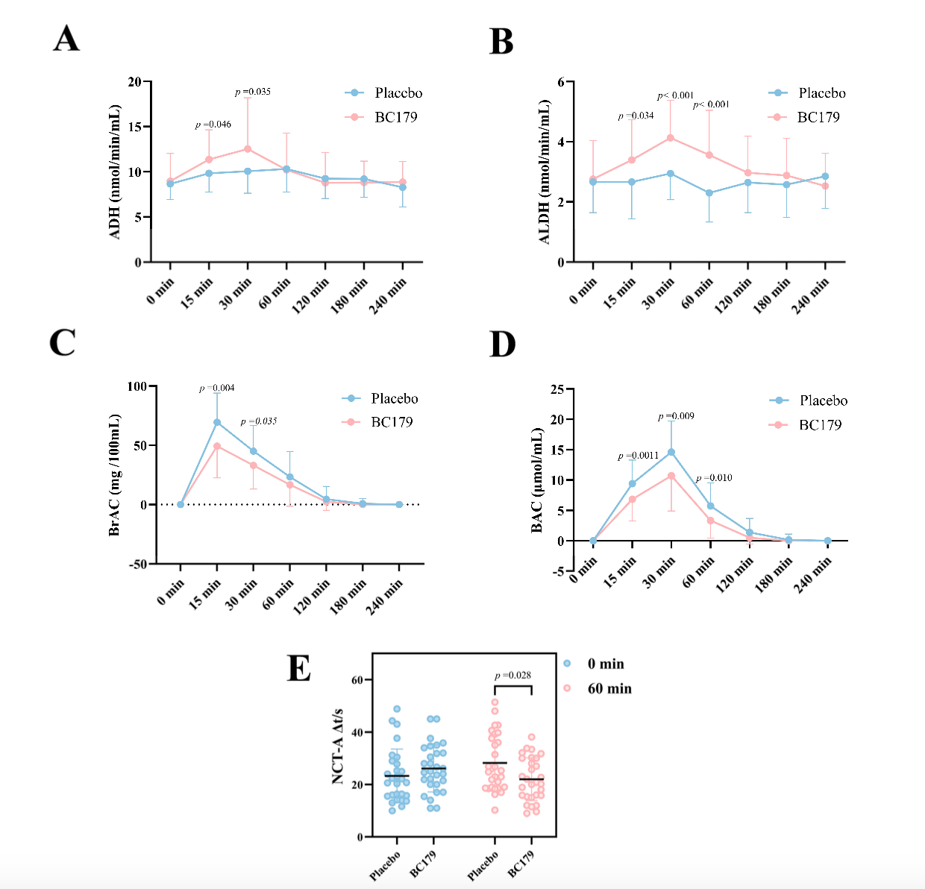

Solution
Relief of Alcohol-related Discomfort
Research Outcome
Accelerated alcohol and acetaldehyde breakdown to support faster recovery of alertness
Reduced blood and breath alcohol levels to shorten systemic alcohol exposure
Improved cognitive respond following alcohol intake
Alleviated metabolic burden of alcohol metabolism to support a more comfortable post-drinking experience
Probiotic
Probiotic
Accelerate alcohol and acetaldehyde metabolism
Support rapid reduction of blood and breath alcohol levels
Support short-term cognitive performance following alcohol intake
Probiotic
Probiotic
Placebo
Placebo
Probiotic
Probiotic
DOI : 10.3390/antiox14091038.
BC179 group showed a significant reduction in hangover symptom scores, along with markedly increased serum ADH and ALDH levels and a significant decrease in blood alcohol concentration. In addition, the BC179 group exhibited significant reductions in serum alkaline phosphatase and plasma endotoxin levels.

Slide 46
Solution
Lipid Homeostasis Regulation
Bifidobacterium breve BBr60; Lacticaseibacillus rhamnosus LRa05;
Bifidobacterium longum subsp. longum BL21; Weizmannia coagulans BC179;
Akkermansia muciniphila Akk11/pAkk11; Weizmannia coagulans BC99
Key Excipients: Turmeric Powder; Natto Powder
Other Excipients: Inulin; Potato Starch
Functionality
Modulates blood lipid levels
Reduces total cholesterol and triglyceride levels effectively
Contributes to the maintenance of cardiovascular health
6 Strains
Optional Excipients
Powder / Capsule Form
Scientific Support
CLINICAL STUDIES
LRa05+BC99+BC179: ChiCTR2400082180 | BBr60: NCT06305650 NCT06196892
BL21: NCT06140641 | Akk11: NCT06780007
pAkk11: NCT06964932 NCT06964919

Slide 47

Solution
Lipid Homeostasis Regulation
Effective Regulation of Blood Lipid Levels
Research Outcome
Increased GLP-1 levels, contributing to the regulation of appetite and glycemic control
Improved lipid metabolism, supporting cardiovascular and cerebrovascular health
Through coordinated hormonal and metabolic regulation, probiotics promoted overall metabolic balance and activated intrinsic health-regulating mechanisms
TC (mmol/L)
TG (mmol/L)
Placebo
Probiotic
Placebo
Probiotic
Placebo
Probiotic
HDL-C (mmol/L)
LDL-C (mmol/L)
DOI : 10.3390/antiox14091038
DOI : 10.1186/s12986-025-00969-2.
Placebo
Probiotic
Placebo
Probiotic

Slide 48
Solution
Body Management and Muscle Support
Bifidobacterium breve BBr60; Lacticaseibacillus rhamnosus LRa05;
Bifidobacterium longum subsp. longum BL21; Bifidobacterium animalis subsp. lactis BLa80;
Lactiplantibacillus plantarum Lp90; Limosilactobacillus reuteri LR08;
Weizmannia coagulans BC99
Key Excipients: Vitamin B6; Vitamin K2; Black Pepper Extract; Green Tea Powder；Blood Orange Concentrate Powder
Other Excipients: Inulin; Fructo-oligosaccharides; Potato Starch
Functionality
Modulates blood glucose levels
Reduces glycated hemoglobin (HbA1c) and insulin levels to maintain metabolic balance
Promotes metabolic health to support muscle function and physical performance
7 Strains
Optional Excipients
Powder / Capsule Form
Scientific Support
CLINICAL STUDIES
LRa05: NCT06821789 | BL21: NCT06140641
BBr60: NCT06305650 | BLa80: ChiCTR2300073412
Lp90: NCT06987279 | LR08: NCT06875362
BC99: NCT06307821

Slide 49


Solution
Body Management and Muscle Support
Research Outcome
Improved insulin utilization efficiency, supporting glucose metabolism and glycemic control
Enhanced metabolic flexibility, promoting fat oxidation and efficient energy utilization in skeletal muscle.
Multidimensional metabolic support contributing to coordinated management of body fat and lean mass
Improved glycemic regulation, including reduced blood glucose, glycated hemoglobin (HbA1c), and insulin levels
TG (mmol/L)
Enhanced lipid
metabolic efficiency
Placebo
Probiotic
FBG (mmol/L)
Changes in Blood Glucose Markers Before and After Intervention
Improved glycemic
metabolic regulation
Placebo
Probiotic
Placebo_Pre
Placebo_Post
Probio_Pre
Probio _Post
HbA1c (%)
INS (pmol/L)

Slide 50
Solution
Uric Acid Metabolism Regulation
Bifidobacterium breve BBr60; Lacticaseibacillus rhamnosus LRa05;
Bifidobacterium longum subsp. longum BL21; Bifidobacterium animalis subsp. lactis BLa80;
Lactobacillus acidophilus LA85; Lacticaseibacillus paracasei LC86;
Pediococcus acidilactici PA53; Lactiplantibacillus plantarum Lp05;
Streptococcus salivarius subsp. thermophilus ST36; Weizmannia coagulans BC99
Excipients: Inulin;Fructo-oligosaccharides; Potato Starch
Functionality
10 Strains
Modulates immune factor levels associated with uric acid metabolism
Reduces inflammation markers
Supports overall balance of immune and inflammatory responses
Optional Excipients
Powder / Capsule Form
Scientific Support
CLINICAL STUDIES
BLa80+LRa05+BC99+BL21+LA85+LC86+BBr60+PA53+Lp05: NCT06781814 NCT07025798 | ST36: NCT06779994

Slide 51




Solution
Uric Acid Metabolism Regulation
Modulation of Immune Factor Levels
Research Outcome
Modulated immune factor levels to enhance immune homeostasis associated with uric acid metabolism
Reducted systemic inflammation and inflammatory markers
Supported balanced immune and inflammatory responses, promoting overall immune regulation
Immunoglobulin level
μg/mL
Ferric benzoate blue-white level (μg/mL)
Reduction of Inflammation Levels
Calprotectin (μg/mL)
IgA (g/L)
IgG (g/L)
DOI: 10.3390/nu17172886
DOI: 10.3389/fnut.2025.1696243
Placebo
Probiotic
Placebo
Probiotic
Placebo
Probiotic

Slide 52
Solution
Blood Pressure Homeostasis Support
Bifidobacterium breve BBr60; Lacticaseibacillus rhamnosus LRa05;
Bifidobacterium longum subsp. longum BL21; Lactiplantibacillus plantarum Lp90;
Bifidobacterium animalis subsp. lactis BLa36; Lacticaseibacillus casei LC89;
Pediococcus acidilactici CCFM7902; Bifidobacterium adolescentis BAC30;
Weizmannia coagulans BC99
Key Excipients: Edible Mushroom Concentrate Powder (Agaricus bisporus)
Other Excipients: Inulin;Fructo-oligosaccharides; Potato Starch
Functionality
Improves blood lipid levels
Reduces inflammation levels
Modulates gut microbiota composition
Increases short-chain fatty acid (SCFA) levels
9 Strains
Optional Excipients
Powder / Capsule Form
Scientific Support
CLINICAL STUDIES
LRa05: ChiCTR2300073308 NCT06901791 | BL21+BBr60+Lp90+BLa36+LC89+CCFM7902+BAC30: NCT06873412
BC99: NCT06629441

Slide 53
Solution
Blood Pressure Homeostasis Support
Research Outcome
6 weeks
6 weeks
12 weeks
Improved blood lipid profiles and supported blood pressure homeostasis, contributing to overall cardiometabolic health
Promoted glucose regulation, lowered fasting blood glucose, HbA1c and insulin levels
Reduced systemic inflammation and regulated immune factor levels, maintaining a balanced immune and inflammatory state
Gut microbiota composition was modulated and short-chain fatty acid (SCFA) production increased
Placebo
Probiotic
Placebo
Probiotic
Placebo
Probiotic
After 6 weeks of probiotic treatment, HDL-C was significantly increased and FBG was significantly decreased compared with placebo.
DOI: 10.4239/wjd.v16.i7.106821

Slide 54
Solution
Integrated Management of Hypertension, Hyperglycemia, and Hyperlipidemia
Bifidobacterium breve BBr60; Lacticaseibacillus rhamnosus LRa05;
Bifidobacterium longum subsp. longum BL21; Bifidobacterium animalis subsp. lactis BLa80;
Limosilactobacillus reuteri LR08; Weizmannia coagulans BC99
Key Excipients: Turmeric Powder; Vitamin D3
Other Excipients: Inulin;Fructo-oligosaccharides; Potato Starch
Functionality
Modulates lipid metabolism to support healthy blood lipid levels
Improves gastrointestinal function to enhance glucose–lipid regulation
Balances immune factors to reduce metabolic inflammation and improve metabolic resilience
Regulates gut microbiota composition
6 Strains
Optional Excipients
Powder / Capsule Form
Scientific Support
CLINICAL STUDIES
BLa80: ChiCTR2300073412 | LRa05: ChiCTR2300073308 NCT06901791
BBr60: NCT06305650, NCT06196892 | LR08: ChiCTR2300073299
BC99: NCT06307821

Slide 55



Solution
Integrated Management of Hypertension, Hyperglycemia, and Hyperlipidemia
Research Outcome
Regulated lipid metabolism and supported blood lipid homeostasis
Improved gastrointestinal health and optimized digestion and nutrient absorption
Modulated gut microbiota composition, contributing to integrated management of cardiometabolic risk factors
Balanced immune factor levels, enhancing metabolic resilience
Uric acid (μmol/L)
Uric Acid (μmol/L, Male)
HDL (μmol/L)
Placebo
Probiotic
Placebo_Pre
Placebo_Post
Probio_Pre
Probio _Post
Placebo
Probiotic
Compared with placebo, probiotic intervention significantly reduced participants’ uric acid levels. In addition, the intervention markedly increased high-density lipoprotein (HDL) levels.
DOI: https://doi.org/10.3390/ijms252010871

Slide 56


WecPro®-Gastrointestinal Health
Designed specifically for gastrointestinal health
Supports gastrointestinal function and microbiome balance; helps relieve constipation and diarrhea; supports gut motility and intestinal barrier health.
Solutions
Improvement of Constipation and Bowel Movement Difficulty
Diarrhea Symptom Relief
Gastric Protection and Helicobacter pylori Management Support
Regulation of Constipation-Predominant (IBS-C)
Gastrointestinal Motility Regulation
Support for Chemo- and Radiotherapy-Assoc. Intestinal Injury
Gut Microbiota Homeostasis Regulation
42+
Clinical Studies
BLa80
Bifidobacterium animalis subsp. lactis
LRa05
Lacticaseibacillus
rhamnosus

Slide 57
Solution
Improvement of Constipation and Bowel Movement Difficulty
Bifidobacterium animalis subsp. lactis BLa80; Lacticaseibacillus rhamnosus LRa05;
Lactobacillus acidophilus LA85; Bifidobacterium longum subsp. longum BL21;
Bifidobacterium breve BBr60; Bifidobacterium adolescentis BAC30;
Bifidobacterium longum subsp. infantis BI45; Weizmannia coagulans BC99
Excipients: Inulin; Fructo-oligosaccharides; Resistant Dextrin; Potato Starch
Functionality
Promotes intestinal motility and increases bowel movement frequency
Alleviates constipation symptoms
Elevates levels of neurotransmitters and hormones associated with gastrointestinal motility
8 Strains
Optional Excipients
Powder / Capsule Form
Scientific Support
CLINICAL STUDIES
BLa80: NCT05980988 NCT04798417 | BLa80+BL21+BBr60+BAC30+BI45: NCT06847919
LRa05: NCT06103240 ChiCTR2300072220 ChiCTR2100053700 | BC99: ChiCTR2200065493 NCT06637397

Slide 58


Solution
Improvement of Constipation and Bowel Movement Difficulty
8 weeks
Research Outcome
Promote intestinal peristalsis and alleviates difficulty in defecation
Increase bowel movement frequency and improves constipation symptoms
Significantly increased Bristol Stool Scale scores and bowel movement frequency
Improves constipation-related symptoms such as dry/hard stools, bloating, and abdominal pain.
Elevated levels of neurotransmitters and hormones associated with gastrointestinal motility
48.6%
3.29
50.8%
0.87
In constipated patients, a significant increase of 50.8% in the neurotransmitter serotonin and a 48.6% rise in the hormone motilin.
Probiotic intervention significantly increased the spontaneous bowel movement score (by 0.87 points) and significantly reduced the constipation symptom assessment score (by 3.29 points) in constipated patients.
DOI: 10.1163/18762891-bja00038
DOI: 10.3389/fnut.2024.1395083
DOI: 10.1007/s00394-025-03586-0
DOI: 10.3390/foods14040654
Diarrhea Symptom Relief

Slide 59
Solution
Diarrhea Symptom Relief
Bifidobacterium animalis subsp. lactis BLa80; Lacticaseibacillus rhamnosus LRa05;
Lactobacillus acidophilus LA85; Bifidobacterium longum subsp. longum BL21;
Bifidobacterium breve BBr60; Weizmannia coagulans BC99
Key Excipients: Yeast Beta-Glucan
Other Excipients: Fructo-oligosaccharides; Acacia Gum;
Resistant Dextrin; Potato Starch
Functionality
6 Strains
Significantly increases the efficacy rate of diarrhea treatment
Alleviates diarrhea symptoms
Improves stool consistency
Optional Excipients
Powder / Capsule Form
Scientific Support
CLINICAL STUDIES
BLa80: ChiCTR2100053699 NCT05662514 | LRa05: ChiCTR2100053700
LA85: NCT05974657 | BL21: ChiCTR2300069881
BBr60: NCT06305650 NCT06196892 | BC99: NCT06629441

Slide 60

Solution
Diarrhea Symptom Relief
Research Outcome
7 days
2 weeks
Significantly increases the efficacy rate of diarrhea treatment
The proportion of patients with diarrhea is significantly reduced
Significantly increased the efficacy rate of diarrhea treatment.
Alleviated diarrhea symptoms in ADD patients, with a significant reduction in the proportion of patients experiencing diarrhea.
Promoted the restoration of normal bowel movements, transitioning stool consistency from acute watery diarrhea back to a normal form.
Probiotic intervention effectively improved diarrhea symptoms, with a 34.5% increase in the significant efficacy rate, a 4.6% rise in the effective rate, and a 39.1% improvement in the overall efficacy rate.
Probiotic intervention alleviates diarrhea symptoms in ADD patients. The proportion of patients experiencing diarrhea is significantly reduced (17.2% vs 0%).
DOI: 10.1038/s41430-024-01428-6
DOI: 10.1002/fsn3.70490
DOI: 10.3390/nu17193087
DOI: 10.3389/fnut.2024.1479186
DOI: 10.1016/j.clnu.2025.07.004
Diarrhea Symptom Relief

Slide 61
Solution
Gastric Protection and Helicobacter pylori Management Support
Bifidobacterium animalis subsp. lactis BLa80; Lacticaseibacillus rhamnosus LRa05;
Bifidobacterium longum subsp. longum BL21; Bifidobacterium breve BBr60;
Lactiplantibacillus plantarum Lp05; Weizmannia coagulans BC99
Key Excipients: L-Glutamine
Other xcipients: Fructo-oligosaccharides; Resistant Dextrin; Potato Starch
Functionality
Significantly increases the eradication rate of Helicobacter pylori
Alleviates gastrointestinal-related adverse reactions caused by Helicobacter pylori treatment
Promotes the restoration of gut microbiota diversity
6 Strains
Optional Excipients
Powder / Capsule Form
Scientific Support
CLINICAL STUDIES
BLa80: NCT05662514 | LRa05: ChiCTR2300072220
BL21: NCT06544278 | BC99: ChiCTR2300073499
Lp05: ChiCTR2400079562 | BBr60: NCT06305650 NCT06196892

Slide 62

Solution
Gastric Protection and Helicobacter pylori Management Support
4 weeks
4 weeks
Research Outcome
Significantly increased the eradication rate of Helicobacter pylori.
Significantly alleviated gastrointestinal-related adverse reactions induced by Helicobacter pylori treatment.
Promoted the restoration of immune homeostasis.
Modulates the gut microbiota, helps restore microbial diversity, increases beneficial bacteria, and reduces harmful bacteria, improves gastric function.
Significantly enhances the eradication rate of Helicobacter pylori
Significantly alleviates gastrointestinal-related adverse reactions during Helicobacter pylori treatment
13.98%
Probiotic intervention increased the Helicobacter pylori eradication rate in patients by 13.98%.
Increased the efficacy rates for alleviating abdominal pain by 55.31%, bloating by 31.43%, and acid reflux by 44% in patients. These results indicate that probiotics effectively reduce the occurrence of adverse reactions—such as abdominal pain, bloating, and acid reflux—during Helicobacter pylori treatment.
DOI: 10.1002/fsn3.70490
DOI: 10.1016/j.jff.2025.106681
DOI: 10.3389/fimmu.2024.1450414
DOI: 10.1016/j.clnu.2025.07.004
DOI: 10.3389/fnut.2024.1484646
Diarrhea Symptom Relief

Slide 63
Solution
Regulation of Constipation-Predominant Irritable Bowel Syndrome (IBS-C)
Bifidobacterium animalis subsp. lactis BLa80; Lacticaseibacillus rhamnosus LRa05;
Bifidobacterium longum subsp. longum BL21; Pediococcus acidilactici PA53;
Bifidobacterium bifidum BBi32; Weizmannia coagulans BC99
Excipients: Inulin; Fructo-oligosaccharides; Acacia Gum;
Potato Starch
Functionality
6 Strains
Increases daily bowel movement frequency
Improves stool consistency
Alleviation of IBS symptoms with improvements in quality of life
Optional Excipients
Powder / Capsule Form
Scientific Support
CLINICAL STUDIES
BLa80: NCT04798417 | LRa05: NCT06103240, ChiCTR2300072220, ChiCTR2100053700
BL21: ChiCTR2300069881, NCT06140641, ChiCTR2300073299, NCT06544278 | PA53: NCT06761443, NCT06648590
BBi32: NCT06886711 | BC99: ChiCTR2200065493, NCT06637397

Slide 64
Solution
Regulation of Constipation-Predominant Irritable Bowel Syndrome (IBS-C)
Research Outcome
Average daily bowel
movement frequency
IBS Symptom Assessment
Improved bowel movement frequency and stool consistency
Alleviated the burden of IBS-related symptoms
Supported gut functional health and enhanced quality of life
Probiotic
Probiotic
Probiotic intervention significantly reduced the severity of IBS symptoms, improving symptoms such as abdominal pain, bloating, and bowel habit irregularities.
Probiotic intervention significantly increased the average daily bowel movement frequency.
DOI: 10.1007/s00394-024-03398-8

Slide 65
Solution
Gastrointestinal Motility Regulation
Bifidobacterium animalis subsp. lactis BLa80; Lacticaseibacillus rhamnosus LRa05;
Bifidobacterium breve BBr60; Pediococcus acidilactici PA53;
Streptococcus salivarius subsp. thermophilus ST36; Weizmannia coagulans BC99
Key Excipients: Protease
Other Excipients: Inulin; Fructo-oligosaccharides; Resistant Dextrin；Potato Starch
Functionality
Improves constipation-related symptoms and quality of life
Upregulates of neurotransmitters involved in gastrointestinal motility
Attenuates inflammatory status with modulation of metabolic pathways associated with gastrointestinal motility
6 Strains
Optional Excipients
Powder / Capsule Form
Scientific Support
CLINICAL STUDIES
BLa80: NCT04798417 | LRa05: ChiCTR2300072220
BBr60: NCT06196892 | PA53: NCT06761443, NCT06648590
ST36: NCT06779994 | BC99: ChiCTR2200065493, NCT06637397, NCT06307821

Slide 66




Solution
Gastrointestinal Motility Regulation
Research Outcome
Promote gastrointestinal peristalsis
Increase bowel movement frequency
Improved bowel function and enhanced intestinal transit
Modulated multiple pathways involved in GI motility—including neurotransmitter signaling, inflammatory mediators, and metabolic pathways
Promoted the restoration of gastrointestinal motor function and improves gut health and quality of life
8 weeks of probiotic intervention resulted in a significant increase in spontaneous bowel movements, accompanied by marked improvements in constipation- -related symptoms, including hard stools, difficulty in defecation, bloating, and abdominal pain.
8 weeks of Intervention significantly increased serum levels of serotonin (5-hydroxytryptamine, 5-HT) and motilin.
DOI: 10.3390/foods14040654
DOI: 10.3390/nu16233990
DOI: 10.1163/18762891-bja00038

Slide 67
Solution
Support for Chemo- and Radiotherapy-Associated Intestinal Injury
Bifidobacterium animalis subsp. lactis BLa80; Lacticaseibacillus rhamnosus LRa05;
Lactobacillus acidophilus LA85; Bifidobacterium longum subsp. longum BL21;
Bifidobacterium longum subsp. infantis BI45; Weizmannia coagulans BC99
Excipients: Inulin; Potato Starch
Functionality
Reduces risk of developing moderate-to-severe radiation enteritis
Attenuates diarrhea severity
Modulates gut microbiota composition
6 Strains
Optional Excipients
Powder / Capsule Form
Scientific Support
CLINICAL STUDIES
BLa80: ChiCTR2100053699, NCT05662514 | LRa05: ChiCTR2100053700
LA85: NCT05974657 | BL21: ChiCTR2300069881
BI45: NCT06863415 | BC99: ChiCTR2200065493, NCT06637397, NCT06307821

Slide 68


Solution
Support for Chemo- and Radiotherapy-Associated Intestinal Injury
Research Outcome
Attenuation of intestinal injury severity
Reduction in the incidence of diarrhea
Mitigated chemotherapy- and radiotherapy-associated intestinal injury
Modulated gut microbiota composition
Reduced the risk of moderate-to-severe radiation enteritis and alleviated diarrhea
Supported the stabilization and recovery of intestinal function in patients undergoing chemoradiotherapy
The incidence of acute radiation-induced intestinal injury of grade ≥2 (ARE) was significantly reduced from 65.0% to 27.2%.
The incidence of diarrhea decreased from 57.0% to 29.5%.
DOI： 10.3389/fnut.2025.1626169

Slide 69
Solution
Gut Microbiota Homeostasis Regulation
Bifidobacterium animalis subsp. lactis BLa80; Lacticaseibacillus rhamnosus LRa05;
Bifidobacterium longum subsp. longum BL21; Bifidobacterium breve BBr60;
Akkermansia muciniphila Akk11/pAkk11; Weizmannia coagulans BC99
Excipients: Inulin; Fructo-oligosaccharides; Acacia Gum; Resistant Dextrin; Galacto-oligosaccharides; Potato Starch
Functionality
Improve constipation-related symptoms and quality of life
Upregulate of neurotransmitters involved in gastrointestinal motility
Attenuate inflammatory status with modulation of metabolic pathways associated with gastrointestinal motility
6 Strains
Optional Excipients
Powder / Capsule Form
Scientific Support
CLINICAL STUDIES
BLa80: ChiCTR2100053699, NCT05662514, NCT06107049, NCT06103253, ChiCTR2300073412, ChiCTR2300074956, NCT06412042 | LRa05: NCT06103240, ChiCTR2300072220, ChiCTR2100053700, ChiCTR2300073308, NCT06699537, NCT06901791
BL21: ChiCTR2300069881, NCT06140641, ChiCTR2300073299, NCT06544278 | BBr60: NCT06305650, NCT06196892
Akk11: NCT06653101；pAkk11: NCT06964932, NCT06964919 | BC99: ChiCTR2200065493, ChiCTR2300073499, NCT06607562, NCT06077383, NCT06629441, NCT06676111, NCT06885346, NCT06885632

Slide 70




Solution
Gut Microbiota Homeostasis Regulation
Increase in the relative abundance of beneficial bacteria
Decrease in the relative abundance of potentially pathogenic bacteria
Research Outcome
Promoted stable colonization of beneficial bacteria
Inhibited overgrowth of opportunistic pathogenic bacteria
Enhanced gut microbiota diversity
Maintained gut microbial homeostasis and overall functional balance
After 12 weeks of intervention, the probiotic group exhibited significantly higher relative abundances of beneficial bacteria compared with placebo, including Faecalibacterium (10.4% vs. 4.8%) and Bifidobacterium (7.3% vs. 3.0%).
After 12 weeks of intervention, the probiotic group showed significantly lower relative abundances of potential pathogenic bacteria compared with placebo, including Clostridium (0.5% vs. 1.8%) and Escherichia/Shigella (3.4% vs. 6.4%).

Slide 71

WecPro®-Immunological Health
Designed specifically for immunol health
Supports immune defense, helps reduce allergic responses and related inflammation, and promotes immune homeostasis.
Solutions
Symptom Relief for Adult Allergic Rhinitis
Symptom Relief for Pediatric Allergic Rhinitis
Support for Pediatric Atopic Dermatitis Modulation
Immune Defense Support
29+
Clinical Studies
BLa80
Bifidobacterium animalis subsp. lactis
LRa05
Lacticaseibacillus
rhamnosus

Slide 72
Solution
Immune Defense Support
Bifidobacterium animalis subsp. lactis BLa80; Lacticaseibacillus rhamnosus LRa05;
Bifidobacterium longum subsp. longum BL21; Limosilactobacillus reuteri LR08
Bifidobacterium breve BBr60; Bifidobacterium longum subsp. infantis BI45;
Weizmannia coagulans BC99
Key Excipients: Inactive edible yeast; Zinc Gluconate
Other Excipients: Fructo-oligosaccharides; Galacto-oligosaccharides; Maltodextrin
Functionality
Promotes immune homeostasis by supporting balanced immune regulation
Enhances mucosal barrier integrity and supports healthy antimicrobial defense
Modulates inflammatory responses to reduce excessive inflammation
Supports overall immune balance and controlled immune recovery
7 Strains
Optional Excipients
Powder / Capsule Form
Scientific Support
CLINICAL STUDIES
BLa80: ChiCTR2100053699 ChiCTR2300074956 NCT06412042 | BBr60: NCT06305650 NCT06196892 | BC99: ChiCTR2200065493 NCT06607562 NCT06637397 NCT06629441 NCT06680102 NCT06676111 NCT06885346 NCT06885632 | LRa05: ChiCTR2300072220 ChiCTR2100053700 NCT05989295 ChiCTR2400080481 NCT06699537 NCT06821789 NCT06901791
BL21: NCT06544278 | BI45: NCT06863415
LR08: NCT06875362

Slide 73


Solution
Immune Defense Support
8 weeks
Modulation of antimicrobial peptide LL-37 and calprotectin levels
Research Outcome
Significantly reduced antimicrobial peptide LL-37 levels, elevated calprotectin levels, improved mucosal barrier function
Elevated anti-inflammatory factor levels, reduced pro-inflammatory factor levels, effectively modulated systemic inflammatory status
Maintained stable levels of key inflammatory factors, promoted the restoration of immune homeostasis, and supported balanced immune regulation
Probiotic intervention significantly elevated serum immunoglobulin IgA and IgM levels while reducing antimicrobial peptide LL-37 and increasing calprotectin content, enhancing mucosal immunity and modulating innate immune responses.
Probiotic
Probiotic
Probiotic
Probiotic
8 weeks
Reduction in inflammatory levels in patients with constipation
23.25pg/ml
4.96pg/ml
14.08pg/ml
Probiotic intervention significantly reduced patients' pro-inflammatory factor IL-6 levels (p < 0.05) while elevating anti‑inflammatory factors IL-4 and IL-10 (p < 0.01).
Placebo
Probiotic
BC99 group​
Placebo
BC99 group​
BC99 group​
Probiotic
Placebo
Probiotic
DOI: 10.1038/s41430-024-01428-6

Slide 74
Solution
Symptom Relief for Adult Allergic Rhinitis
Bifidobacterium animalis subsp. lactis BLa80; Lacticaseibacillus rhamnosus LRa05;
Bifidobacterium breve BBr60; Pediococcus acidilactici PA53;
Akkermansia muciniphila Akk11/pAkk11; Weizmannia coagulans BC99
Key Excipients: Yeast Beta-Glucan; Chaga Mushroom Powder
Other Excipients: Fructo-oligosaccharides; Galacto-oligosaccharides; Potato Starch
Functionality
Alleviates allergic rhinitis symptoms effectively
Regulates immune factor levels to improve immune homeostasis
Promotes the secretion of short-chain fatty acids to strengthen anti-inflammatory capabilities
6 Strains
Optional Excipients
Powder / Capsule Form
Scientific Support
CLINICAL STUDIES
BLa80: ChiCTR2100053699 ChiCTR2300074956 NCT06412042 | LRa05: NCT06699537
BBr60: NCT06196892 | PA53: NCT06761443, NCT06648590
Akk11: NCT06653101 pAkk11: NCT06964932, NCT06964919 | BC99: NCT06680102, NCT06885346

Slide 75


Solution
Symptom Relief for Adult Allergic Rhinitis
8 weeks
Research Outcome
Participants showed significantly reduced scores for rhinitis symptoms (nasal congestion, itching, sneezing, runny nose) and associated symptoms (post-nasal drip, sudden tearing, nasal and eye itching, nasal and palatal pain, headache).
Alleviated allergic rhinitis and enhanced respiratory comfort
Anti-allergic and anti-inflammatory effects through immune regulation to improve immune homeostasis
Optimized gut microbiota ecology to support microbiota health
Promoted short-chain fatty acid production to strengthen gut barrier and anti-inflammatory capabilities
Visual Model ASR Score
TINSS Score
Probiotic_Pre
Probiotic_Post
Placebo
Probiotic
8 weeks
Participants showed a significant decrease in serum immunoglobulin IgE and pro-inflammatory IL-5 levels, along with a significant increase in anti-inflammatory IL-10 levels.
Placebo
Probiotic
Placebo
Probiotic
Placebo
Probiotic
DOI: 10.3389/fimmu.2025.1654724

Slide 76
Solution
Symptom Relief for Pediatric Allergic Rhinitis
Bifidobacterium animalis subsp. lactis BLa80; Lacticaseibacillus rhamnosus LRa05;
Bifidobacterium longum subsp. longum BL21; Bifidobacterium breve BBr60;
Bifidobacterium longum subsp. infantis BI45; Weizmannia coagulans BC99
Key Excipients: Inactive edible yeast
Other Excipients: Fructo-oligosaccharides; Galacto-oligosaccharides; Maltodextrin
Functionality
Significantly alleviates allergic rhinitis symptoms
Markedly reduces nasal and ocular discomfort, enhancing overall quality of life
Effectively lowers inflammation-related cytokine levels, supporting immune regulation and reducing inflammation
6 Strains
Optional Excipients
Powder / Capsule Form
Scientific Support
CLINICAL STUDIES
BLa80: ChiCTR2100053699 ChiCTR2300074956 NCT06412042 | LRa05: NCT06699537
BBr60: NCT06305650, NCT06196892 | BL21: NCT06544278
BI45: NCT06863415 | BC99: NCT06676111, NCT06885632

Slide 77




Solution
Symptom Relief for Pediatric Allergic Rhinitis
Research Outcome
The total rhinitis symptom score decreased by 1.39 points. Associated symptom score decreased by 3 points.
Significantly alleviated allergic rhinitis symptoms
Markedly reduced nasal and ocular discomfort, effectively improved quality of life
Lowered inflammation-related cytokine levels and alleviate inflammatory responses, scientifically validated immune regulation effects
Total Symptom Score for Allergic Rhinitis (TSS)
Rhinitis Accompanying Symptom Score
8 weeks
Probiotic_Pre
Probiotic_Post
Probiotic_Pre
Probiotic_Post
Compared to baseline, participants' quality of life significantly improved.
Participants' serum IL-4 levels were significantly reduced.
IL-4 (pg/mL)
DOI: 10.1016/j.intimp.2025.115787
8 weeks
Placebo
Probiotic

Slide 78
Solution
Support for Pediatric Atopic Dermatitis Modulation
Bifidobacterium animalis subsp. lactis BLa80; Lacticaseibacillus rhamnosus LRa05;
Bifidobacterium longum subsp. longum BL21; Limosilactobacillus reuteri LR08;
Akkermansia muciniphila Akk11/pAkk11; Weizmannia coagulans BC99
Excipients: Fructo-oligosaccharides; Galacto-oligosaccharides; Maltodextrin
Functionality
6 Strains
Alleviates eczema discomfort and protects sensitive skin
Enhances skin hydration and strengthens the natural skin barrier
Reduces rash incidence, supporting overall skin health and management
Optional Excipients
Powder / Capsule Form
Scientific Support
CLINICAL STUDIES
BLa80: ChiCTR2300074956, NCT06412042 | LRa05: NCT05989295
BL21: NCT06544278 | LR08: NCT06875362
Akk11: NCT06653101 pAkk11: NCT06964932, NCT06964919 | BC99: NCT06676111, NCT06885632

Slide 79

Solution
Support for Pediatric Atopic Dermatitis Modulation
Research Outcome
LRa05 intervention reduced eczema symptoms in children with mild atopic dermatitis.
LRa05 intervention increased skin hydration levels in children.
Reduced eczema symptoms and alleviated discomfort in children with mild atopic dermatitis
Increased skin hydration levels, strengthening the skin's natural barrier
Significantly reduced the incidence of rashes, effectively preventing and improving allergic skin conditions in infants and young children
Improvement in Mild Atopic Dermatitis (%)
Skin Hydration Index Change (%)
No improvement
Probiotic
Probiotics significantly reduced the incidence of rashes in infants and young children.
Bowel Movement Frequency
Incidence of Rash (%)
No intervention
Placebo
Day28 Day56 Day64
Probiotic
Probiotic
DOI: https://doi.org/10.3345/cep.2025.01256

Slide 80

WecPro®-Infant Health
Designed specifically for infant health
Supports early-life development and the establishment of immune and gut microbiome homeostasis.
Solutions
Gut Immune Support in Infants and Young Children
Eczema Risk Management in Infants and Young Children
Neurodevelopmental Support in Infants and Children
Respiratory Health and Immune Support
Gut Microbiota Modulation in C-section Delivered Infants
7+
Clinical Studies
BLa80
Bifidobacterium animalis subsp. lactis
LRa05
Lacticaseibacillus
rhamnosus

Slide 81
Solution
Gut Immune Support in Infants and Young Children
Bifidobacterium animalis subsp. lactis BLa80;
Lacticaseibacillus rhamnosus LRa05
Excipients: Fructo-oligosaccharides; Galacto-oligosaccharides; Resistant Dextrin; 2'-Fucosyllactose; Maltodextrin
Functionality
Enhances immune defense capacity
Enriches functional genes associated with immune regulation in the gut microbiome
Increases gut microbial species diversity
2 Strains
Optional Excipients
Powder / Capsule Form
Scientific Support
CLINICAL STUDIES
BLa80: ChiCTR2100053699 ChiCTR2300074956 NCT06412042 | LRa05: ChiCTR2100053700

Slide 82

Solution
Gut Immune Support in Infants and Young Children
7 days
Research Outcome
Significantly increased antimicrobial peptide LL-37 and human β-defensin-2
Enhanced local immune defense in response to infection or inflammatory stimuli
Probiotic intervention significantly elevated levels of antimicrobial peptide LL-37 and human β-defensin-2 (hBD-2).
735.51pg/g
DOI: 10.1038/s41430-024-01428-6
DOI: https://doi.org/10.3345/cep.2025.01256

Slide 83
Solution
Eczema Risk Management in Infants and Young Children
Bifidobacterium animalis subsp. lactis BLa80;
Lacticaseibacillus rhamnosus LRa05
Excipients: Fructo-oligosaccharides; Resistant Dextrin; Maltodextrin
Functionality
Significantly improves the eczema remission rate
Reduces the frequency of eczema episodes
Improves skin hydration
2 Strains
Optional Excipients
Powder / Capsule Form
Scientific Support
CLINICAL STUDIES
BLa80: ChiCTR2300074956 NCT06412042 | LRa05: NCT05989295

Slide 84

Solution
Eczema Risk Management in Infants and Young Children
12 weeks
Research Outcome
Significantly reduced the frequency of eczema episodes, and increased the eczema improvement rate.
significantly improves skin hydration.
Probiotic intervention significantly reduced the average number of eczema episodes compared with the breastfed group in infants aged 15 days to 36 months.
Probiotic intervention significantly increased the eczema improvement rate.
DOI: https://doi.org/10.3345/cep.2025.01256

Slide 85
Solution
Neurodevelopmental Support in Infants and Children
Key Excipients: Vtamin D3; Zinc Gluconate
Other Excipients: Fructo-oligosaccharides; Resistant Dextrin; Maltodextrin
Bifidobacterium animalis subsp. lactis BLa80;
Lacticaseibacillus rhamnosus LRa05
Functionality
2 Strains
Supports the development of motor function and coordination
Facilitates language acquisition and cognitive processing
Promotes healthy neurodevelopment in infants and young children
Optional Excipients
Powder / Capsule Form
Scientific Support
CLINICAL STUDIES
BLa80: NCT06412042 | BLa80+LRa05: NCT06348121

Slide 86


Solution
Neurodevelopmental Support in Infants and Children
Research Outcome
Promoted development of motor skills, enhanced language learning abilities
Supported healthy neurodevelopment in infants and young children
Provided safe, science-based micro-ecological nutritional support for early growth and development
Improvements in motor skill development were observed only following probiotic intervention. In addition, language acquisition abilities were enhanced.
DOI: 10.3345/cep.2025.01256

Slide 87
Solution
Respiratory Health and Immune Support
Bifidobacterium animalis subsp. lactis BLa80;
Lacticaseibacillus rhamnosus LRa05
Excipients: Fructo-oligosaccharides; Resistant Dextrin; Maltodextrin
Functionality
Improves constipation-related symptoms and quality of life
Upregulates of neurotransmitters involved in gastrointestinal motility
Attenuates inflammatory status with modulation of metabolic pathways associated with gastrointestinal motility
2 Strains
Optional Excipients
Powder / Capsule Form
Scientific Support
CLINICAL STUDIES
 | BLa80+LRa05: NCT06348095

Slide 88




Solution
Respiratory Health and Immune Support
Research Outcome
Significant Reduction in the Incidence of Common Pediatric Diseases
Enhancement of Immune Function in Infants and Young Children
Significant reduction in acute respiratory infections and eczema incidence
Enhanced gut-derived immune defense by activating the gut-lung immune axis
Provided a safe and effective microbiota-based approach to support respiratory immune health
Probiotic intervention significantly decreased the incidence of acute upper respiratory infections and eczema in infants.
Probiotic Intervention significantly elevated levels of LL-37 and HBD-2 in the intestinal mucosa.
DOI: 10.3345/cep.2025.01256

Slide 89
Solution
Gut Microbiota Modulation in C-section Delivered Infants
Bifidobacterium animalis subsp. lactis BLa80;
Lacticaseibacillus rhamnosus LRa05
Excipients: Fructo-oligosaccharides; Galacto-oligosaccharides; Resistant Dextrin; Maltodextrin
Functionality
2 Strains
Improves constipation-related symptoms and quality of life
effectively increases stool frequency in infants and young children, improving bowel health
Promotes the enrichment of beneficial bacteria
Optional Excipients
Powder / Capsule Form
Scientific Support
CLINICAL STUDIES
BLa80: ChiCTR2300074956 | LRa05: NCT05989295

Slide 90

Solution
Gut Microbiota Modulation in C-section Delivered Infants
Research Outcome
Effectively promoting defecation
Promote the enrichment of beneficial bacteria
Promoted regular bowel movements: clinically verified to effectively increase stool frequency in infants and young children, improving bowel health
Regulated gut flora balance: significantly boosts beneficial bacteria such as Bifidobacteria in the gut, supporting healthy growth
The average stool frequency significantly increased in infants and young children aged 15 days to 36 months, indicating that probiotic intervention effectively promotes bowel movements in this population.
Beneficial gut bacteria such as Bifidobacterium and Parabacteroides were significantly increased.
DOI: 10.3345/cep.2025.01256

Slide 91

WecPro®-Dental & Oral Health
Designed specifically for Dental & Oral health
Supports oral microbiome balance and local immunity, promotes periodontal health, and helps maintain fresh breath.
Solutions
Oral Microbiota and Local Immune Regulation
Periodontal Health Improvement Support
Oral Freshness Maintenance
3+
Clinical Studies
LS97
Ligilactobacillus salivarius
LA85
Lactobacillus acidophilus
LC86
Lacticaseibacillus
paracasei

Slide 92
Solution
Oral Microbiota and Local Immune Regulation
Ligilactobacillus salivarius LS97;
Lactobacillus acidophilus LA85;
Lacticaseibacillus paracasei LC86
Functionality
3 Strains
Improves oral microbiota composition
Strengthens oral immune defense
Improves the oral microenvironment
Optional Excipients
Powder / Capsule Form
Scientific Support
CLINICAL STUDIES
LS97+LA85+LC86: ChiCTR2300074088

Slide 93


Solution
Oral Microbiota and Local Immune Regulation
8 weeks
Elevated oral salivary IgA and acetic acid levels
Research Outcome
Enhanced oral immune defense and significantly increase salivary IgA levels.
Supported a healthy oral microenvironment and increases the levels of beneficial short-chain fatty acids (such as acetate and propionate).
Promoted oral microbiota balance and enhanced microbial diversity, and reduced the population of certain potentially harmful bacteria.
Intervention group showed significantly higher levels of salivary IgA and beneficial short-chain fatty acids.
8 weeks
Improved Oral microbial diversity
The oral microbiota α‑diversity in the probiotic group remained higher, and the overall microbiota structure did not undergo significant alteration.

Slide 94
Solution
Periodontal Health Improvement Support
Ligilactobacillus salivarius LS97;
Lactobacillus acidophilus LA85;
Lacticaseibacillus paracasei LC86
Functionality
3 Strains
Enhances oral mucosal immune defense
Reduces probing pocket depth
Improves gingival bleeding and inflammation
Optional Excipients
Powder / Capsule Form
Scientific Support
CLINICAL STUDIES
 | LS97+LA85+LC86: ChiCTR2300074108

Slide 95



Solution
Periodontal Health Improvement Support
Enhanced immune function
Alleviation of periodontal inflammation symptoms
Research Outcome
Significantly increased salivary IgA levels in individuals with periodontitis
Reduced probing pocket depth and lowers bleeding on probing index
Dual effects on immune defense and tissue inflammation, providing a scientific, microbiota-based solution for periodontal health
Probiotic intervention significantly increased salivary IgA levels, reduced probing pocket depth (PD) and bleeding on probing (BOP) values.

Slide 96
Solution
Oral Freshness Maintenance
Ligilactobacillus salivarius LS97;
Lactobacillus acidophilus LA85;
Lacticaseibacillus paracasei LC86
Functionality
Decomposes the source of bad breath gases, directly reducing the production of odor-causing substances
Alleviates oral inflammation
Dual pathway freshening mechanism, reducing inflammatory halitosis
3 Strains
Optional Excipients
Powder / Capsule Form
Scientific Support
CLINICAL STUDIES
 | LS97+LA85+LC86: ChiCTR2400080658

Slide 97



Solution
Oral Freshness Maintenance
Research Outcome
Improve bad breath
Reduced gingival inflammation
Significantly reduced oral volatile sulfur compounds (VSC), addressing bad breath at its source
Effectively lowered gingival inflammatory markers and improved overall oral health
Dual mechanism of action ensures long-lasting fresh breath maintenance
Provided an innovative solution based on oral microbiota balance
Probiotic intervention significantly reduced VSC levels in patients.
Patients' levels of gingival TNF-α and IL-1β were significantly reduced.

